Slide 1

New LJ Institute of Engineering and Technology
Name : Harshal K Acharya
Roll Number(Batch) : B11_12
Department : CSE(AIML) / IT
Topic : Data Analytics and Visualization
with Tableau(Engineering+)

Slide 2
DATA-SOURCE LINKS
COVID-19 Dataset
https://drive.google.com/drive/folders/1pPiCs-x8QuVEfNehzqDQhmL36LwICPt8
2. Netflix Dataset & SuperStore Dataset
https://drive.google.com/drive/folders/1hQZur3Howub0xR5KD3SDfOmdkdLjpLuH?usp=sharing
3 Tableau Practice Datasets
https://www.superdatascience.com/pages/tableau

Slide 3
COVID-19 DATASOURCE
[ Attach snapshots with tooltip for each of the following ]
Create a dashboard with worldwide map, confirmed, recovered and death analysis.
Create a dashboard with nationwide map, confirmed, recovered and death analysis for a specific country.
Apply “Hover” action filter on a selected country to create interactive dashboard.
Apply “Select” action highlight on a selected state to create interactive dashboard.
Change the granularity level to years in both worldwide and nationwide dashboards.

Slide 4
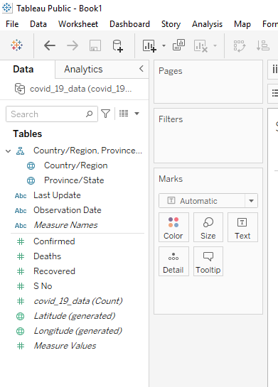
COVID-19 DATASOURCE
Dimensions
Measures

Slide 5

COVID-19 DATASOURCE
Working Area

Slide 6
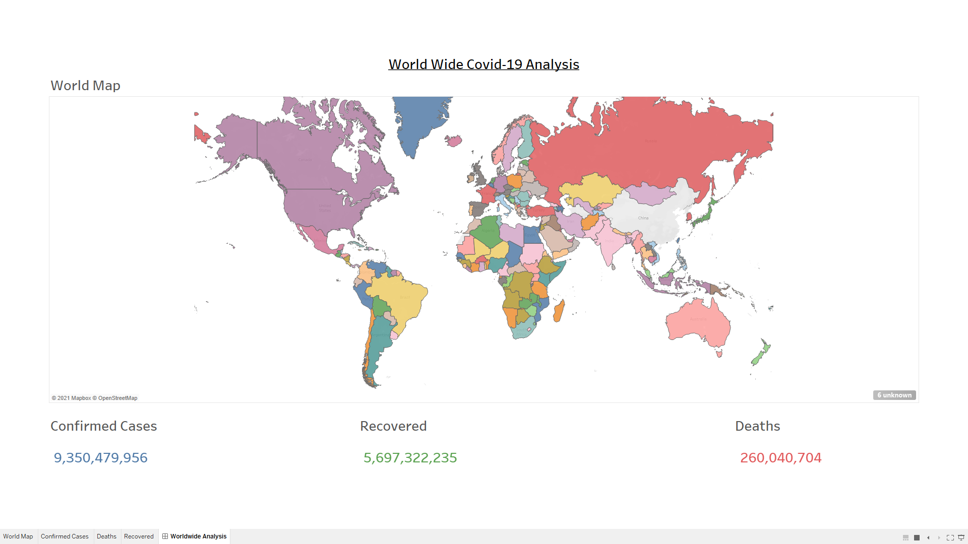
COVID-19 DATASOURCE
1. Create a dashboard with worldwide map, confirmed, recovered and death analysis.

Slide 7
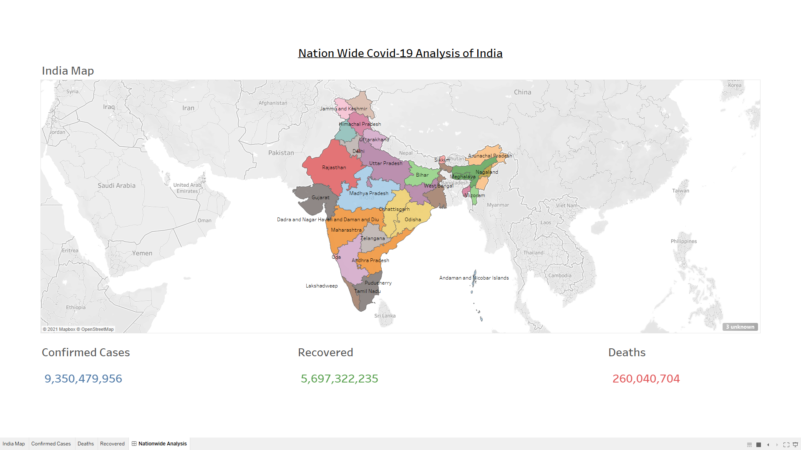
COVID-19 DATASOURCE
2. Create a dashboard with nationwide map, confirmed, recovered and death analysis for a specific country.

Slide 8
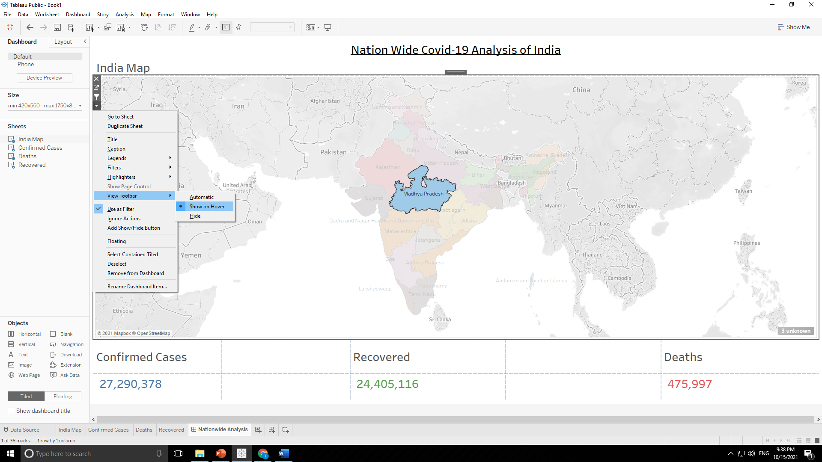
COVID-19 DATASOURCE
3. Apply “Hover” action filter on a selected country to create interactive dashboard.

Slide 9
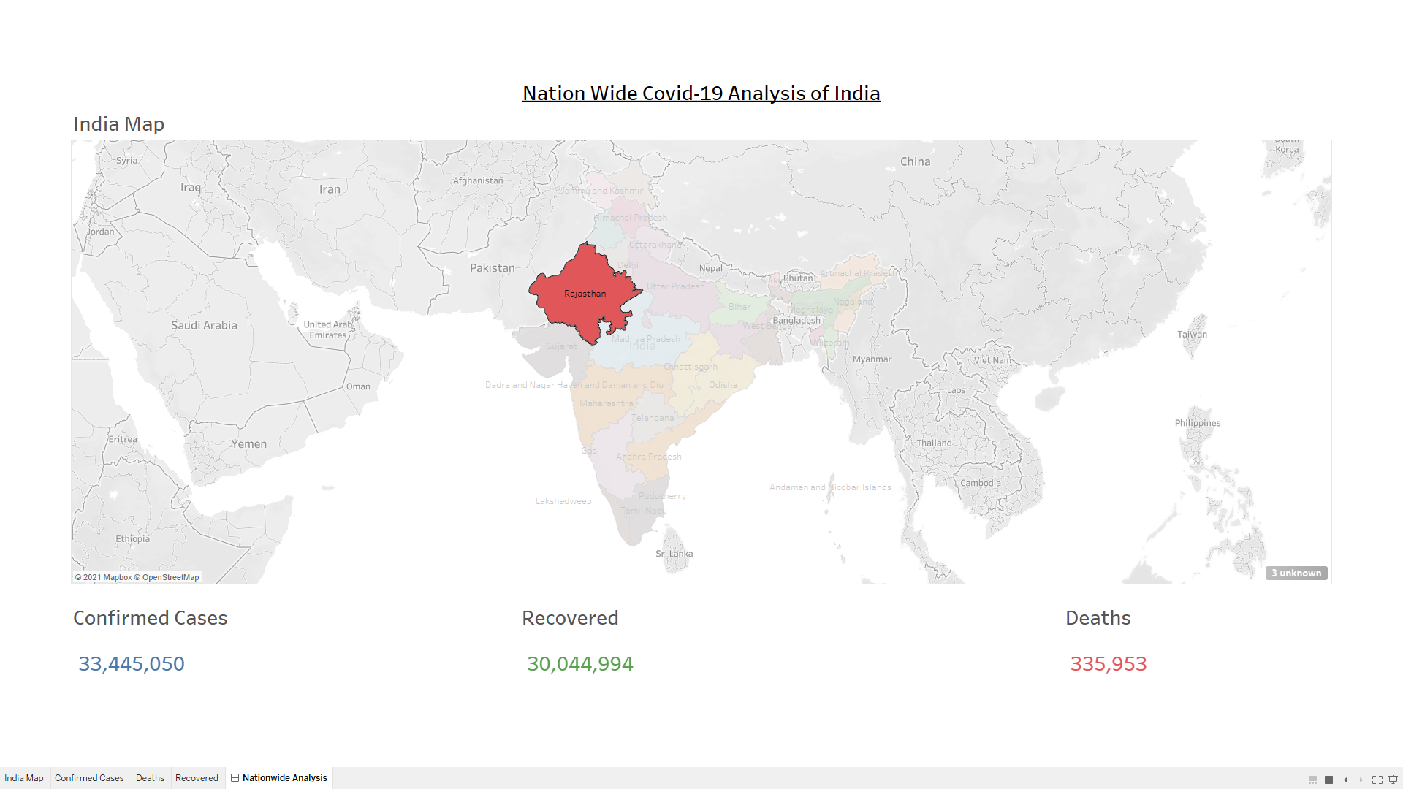
COVID-19 DATASOURCE
Effect on Dashboard:-

Slide 10
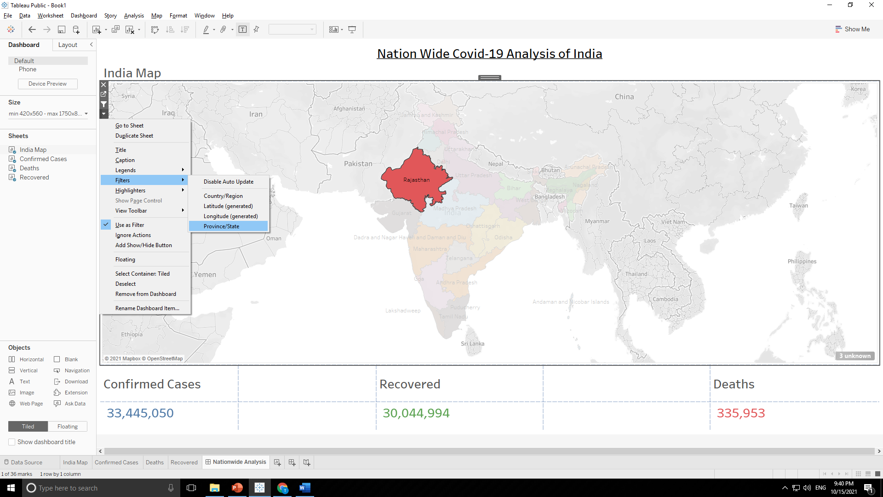
COVID-19 DATASOURCE
4. Apply “Select” action highlight on a selected state to create interactive dashboard.

Slide 11
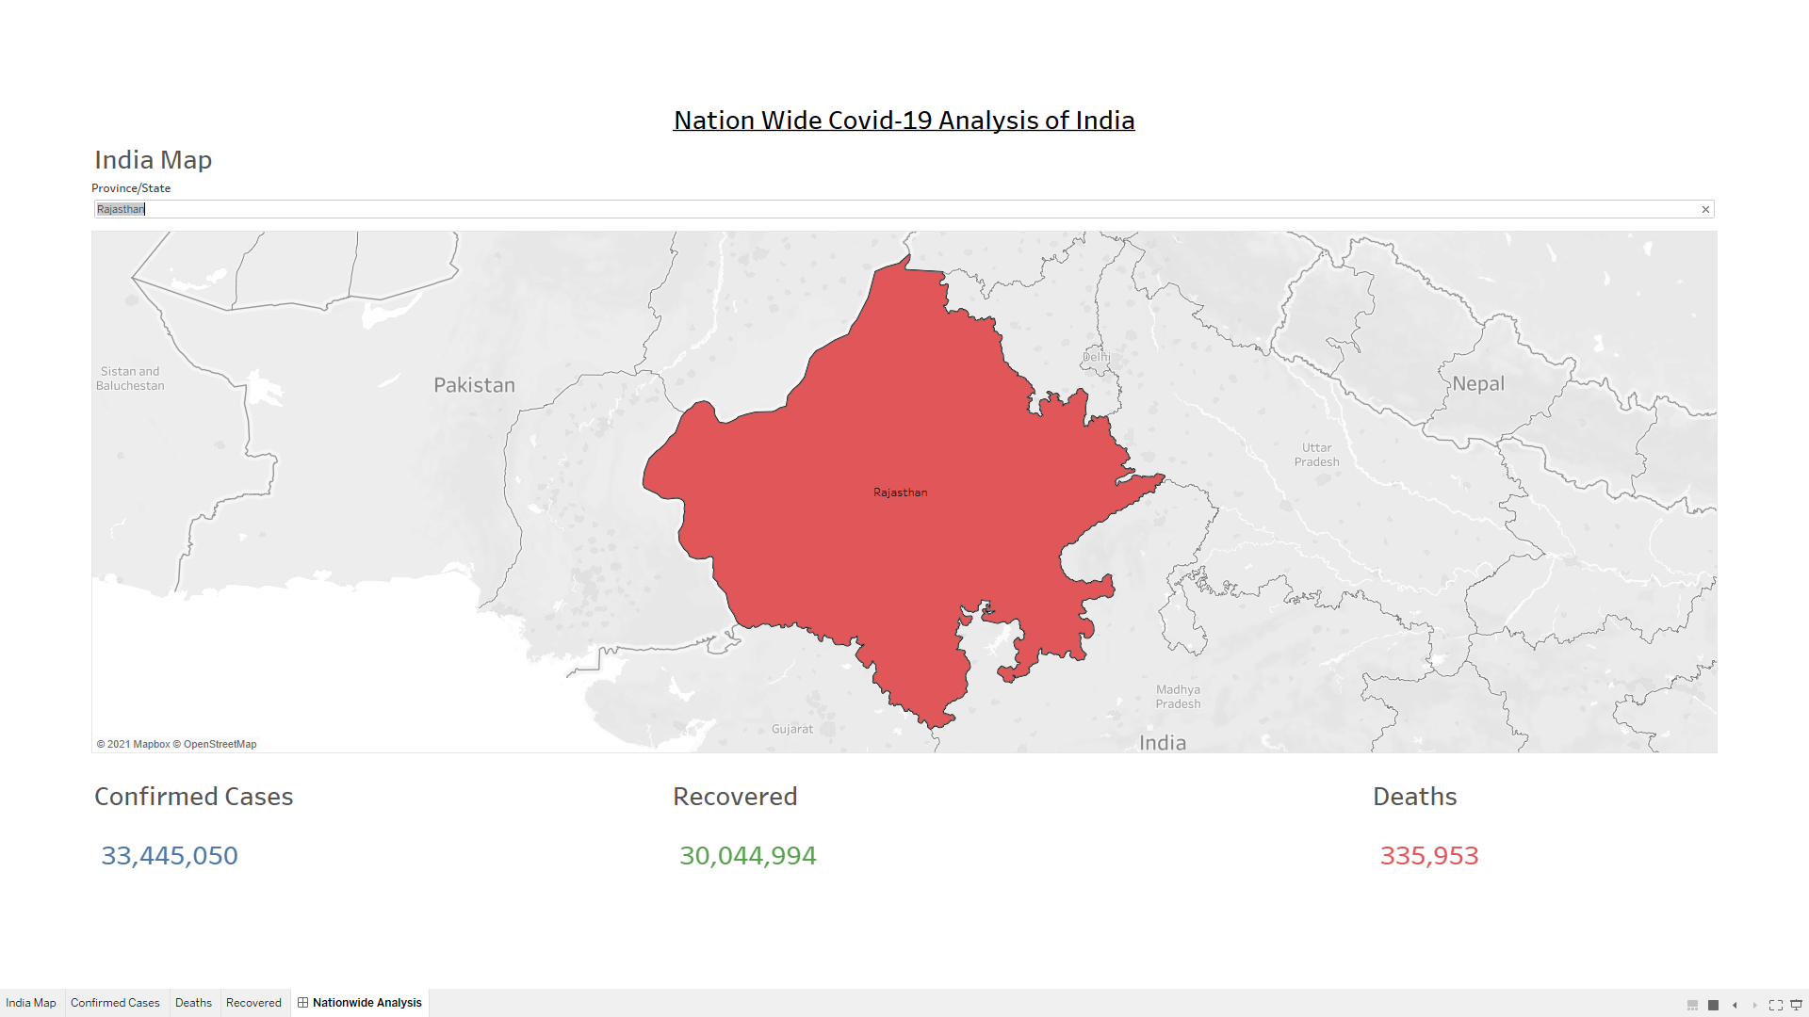
COVID-19 DATASOURCE
Effect on Dashboard:-

Slide 12
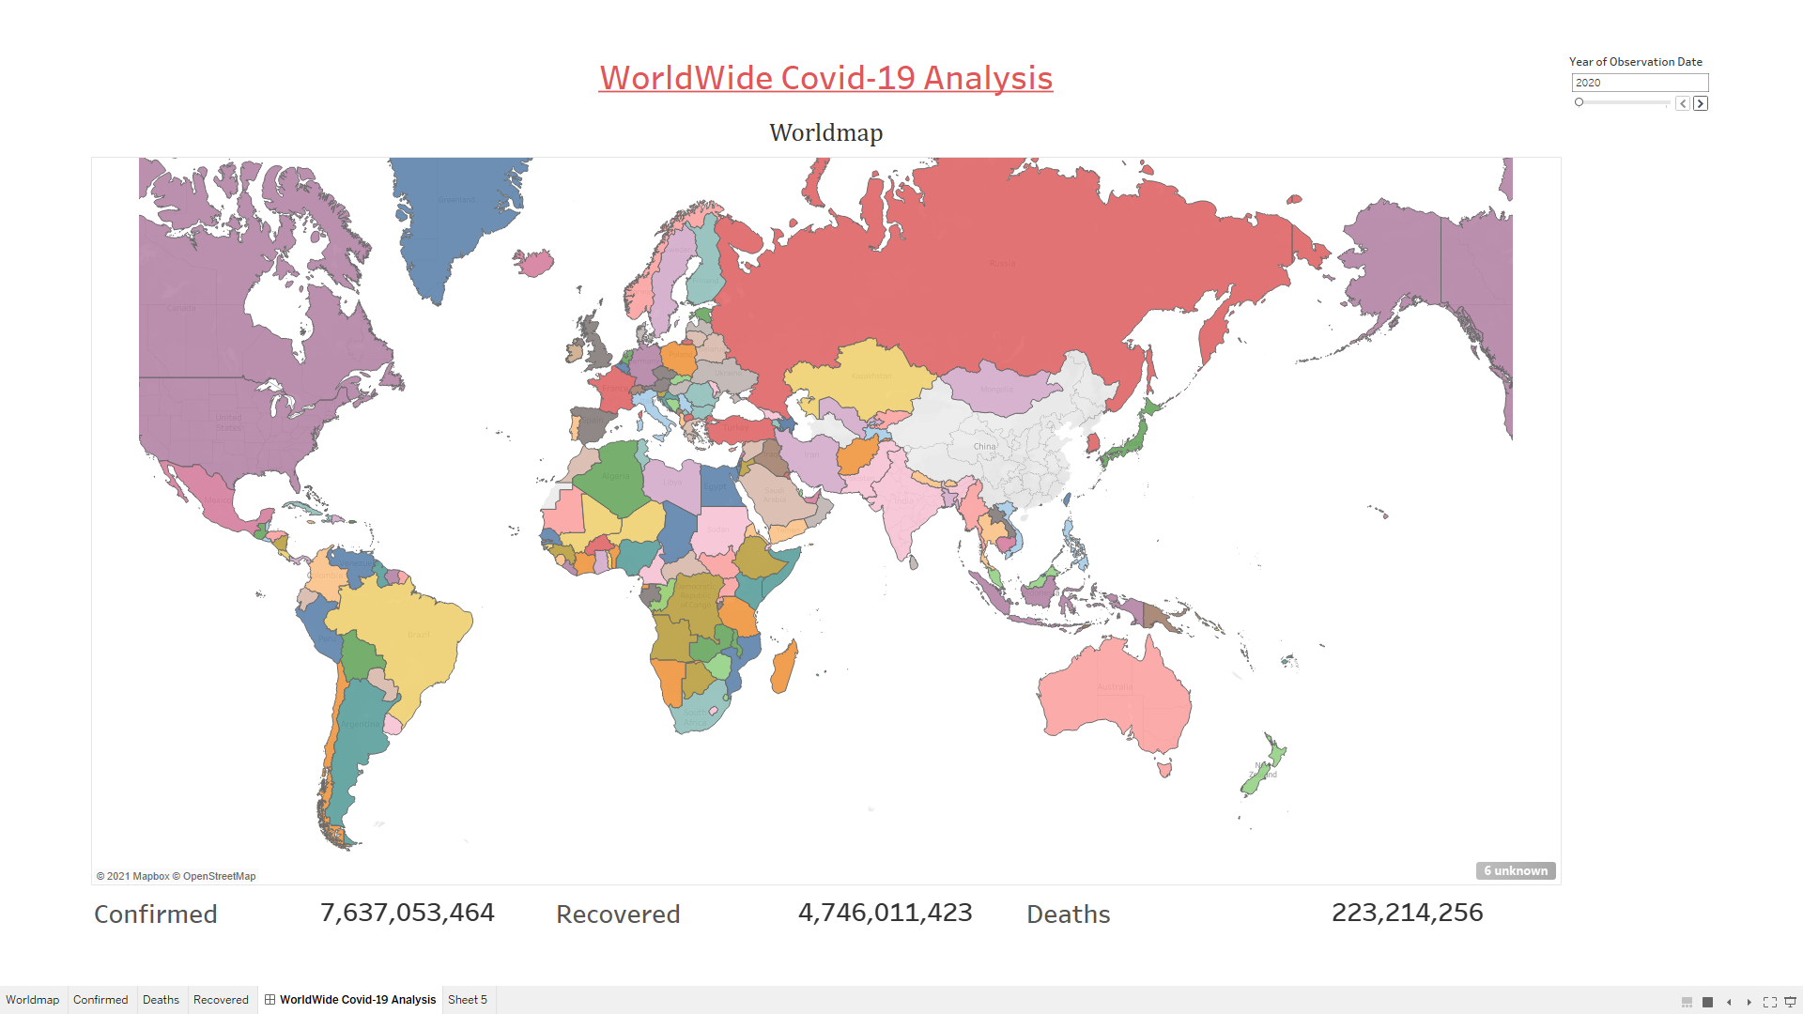
COVID-19 DATASOURCE
5. Change the granularity level to years in both worldwide and nationwide dashboards.

Slide 13
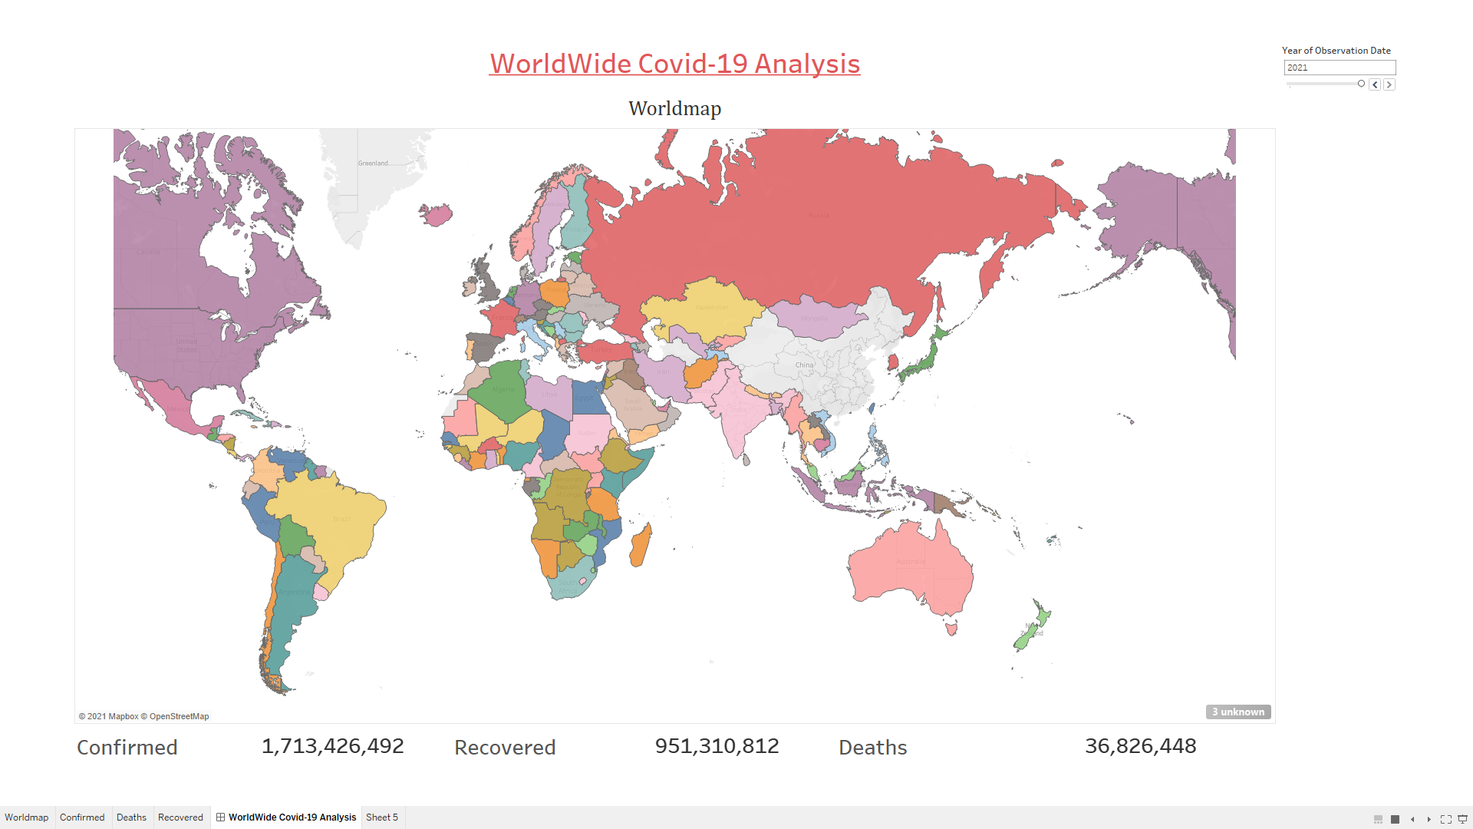
COVID-19 DATASOURCE

Slide 14
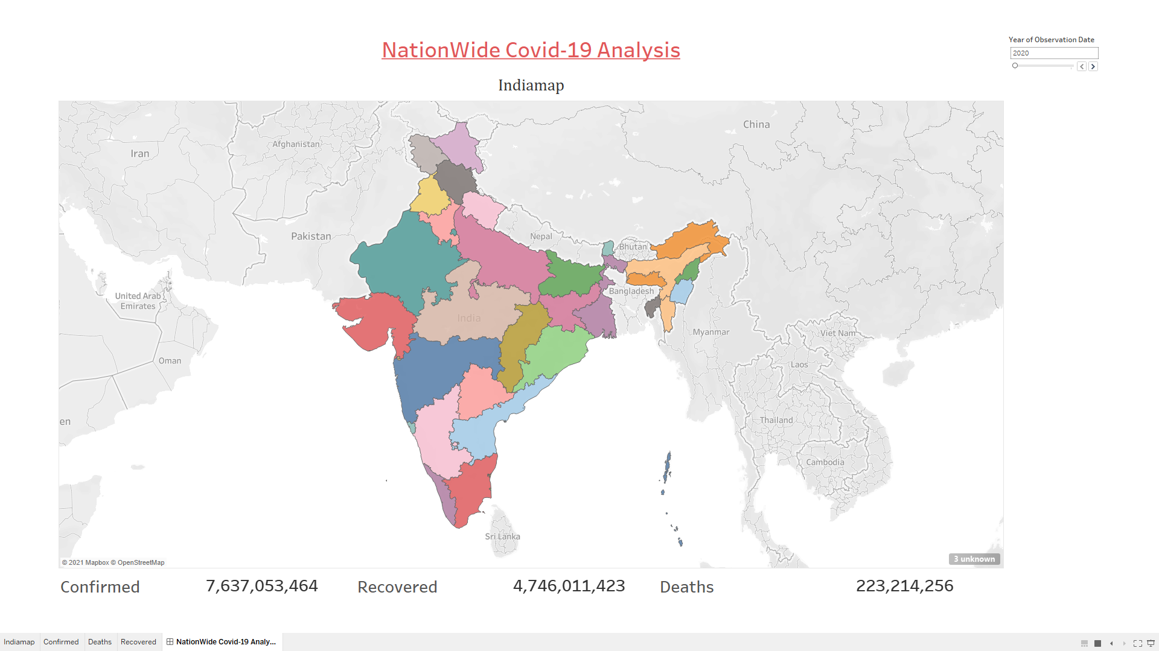
COVID-19 DATASOURCE

Slide 15

COVID-19 DATASOURCE

Slide 16
SUPERSTORE DATASOURCE
[use label formatting for sales and use color palette to distinguish years 2015-2018]
Find the aggregate sales for each month of a year using area chart
Find the aggregate profit for each quarter of a year 2015-2018 using area chart
Plot sales and profit for each month of a year in furniture category
Plot sales and profit for each month of a year in office supplies category in central region
Create interactive dashboard with appropriate graphs and charts using action filters, images and label formatting.

Slide 17
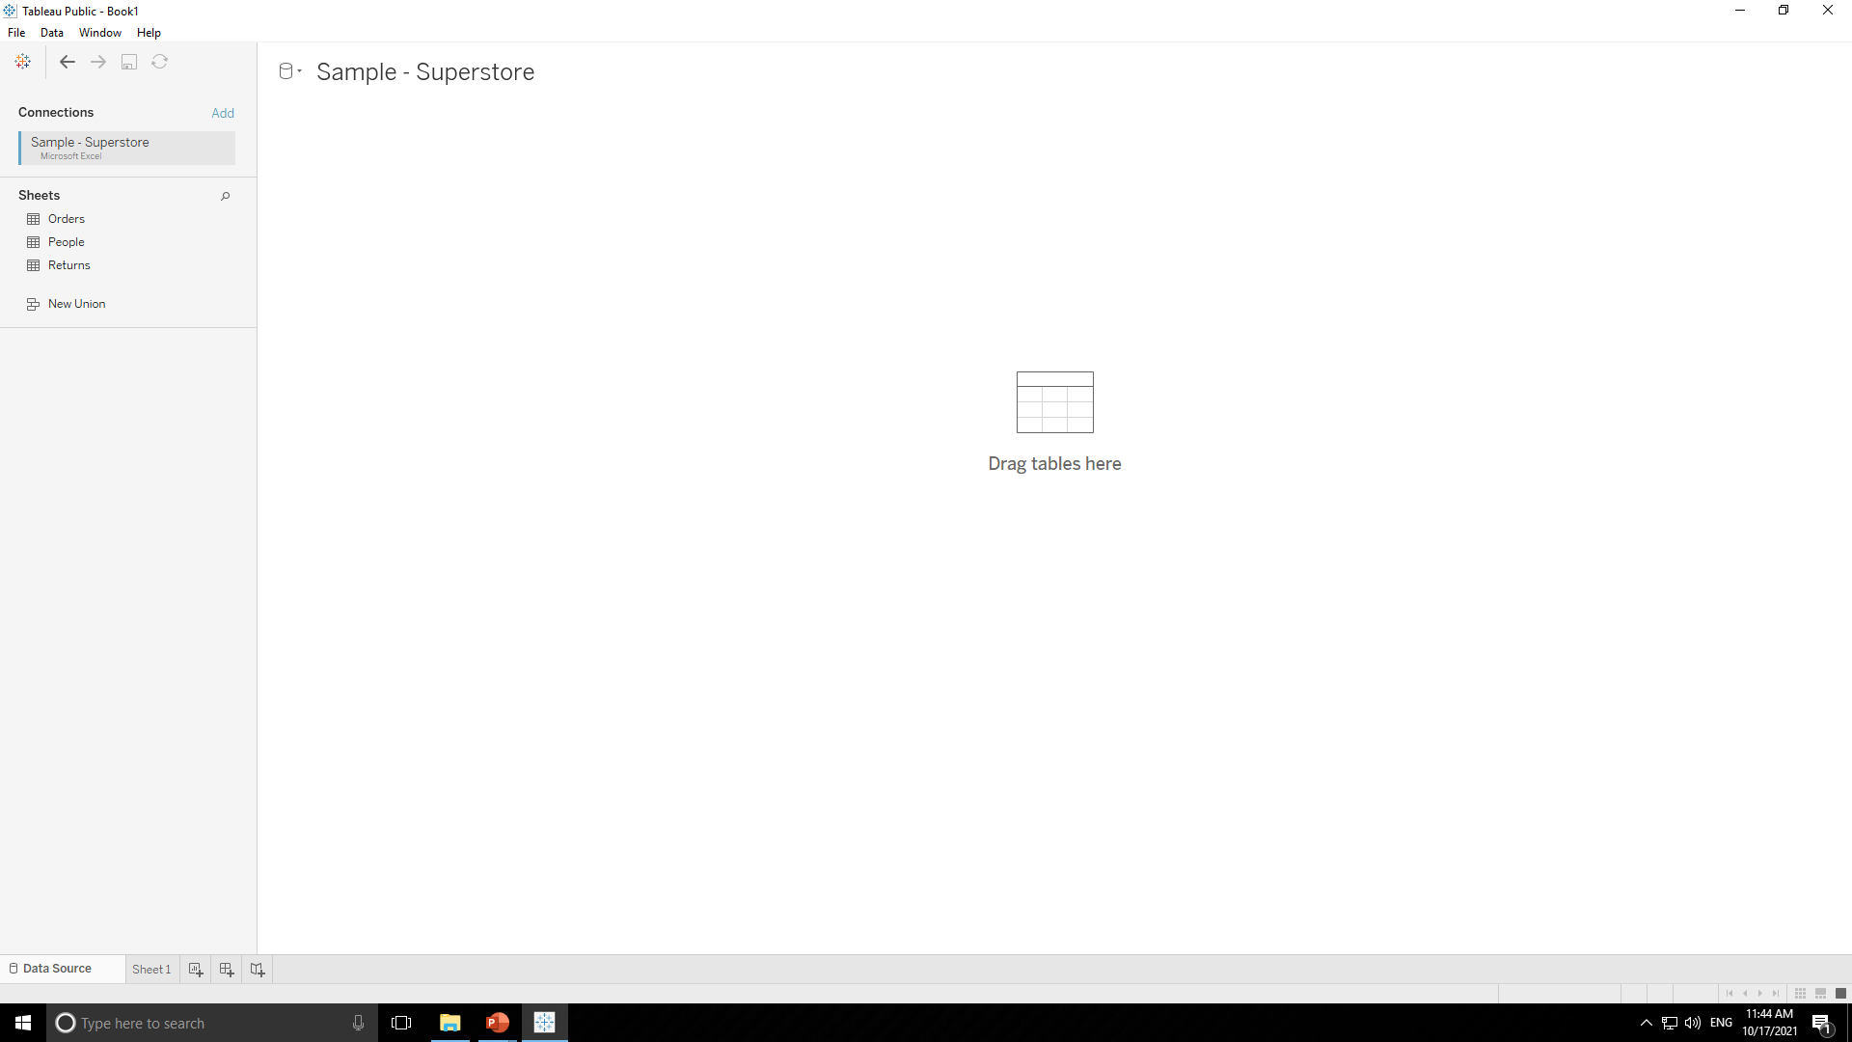
SUPERSTORE DATASOURCE
This dataset contains three tables Orders , People & Return as shown in above image. For any problem statement we will use one table or relation between two table respectively.

Slide 18
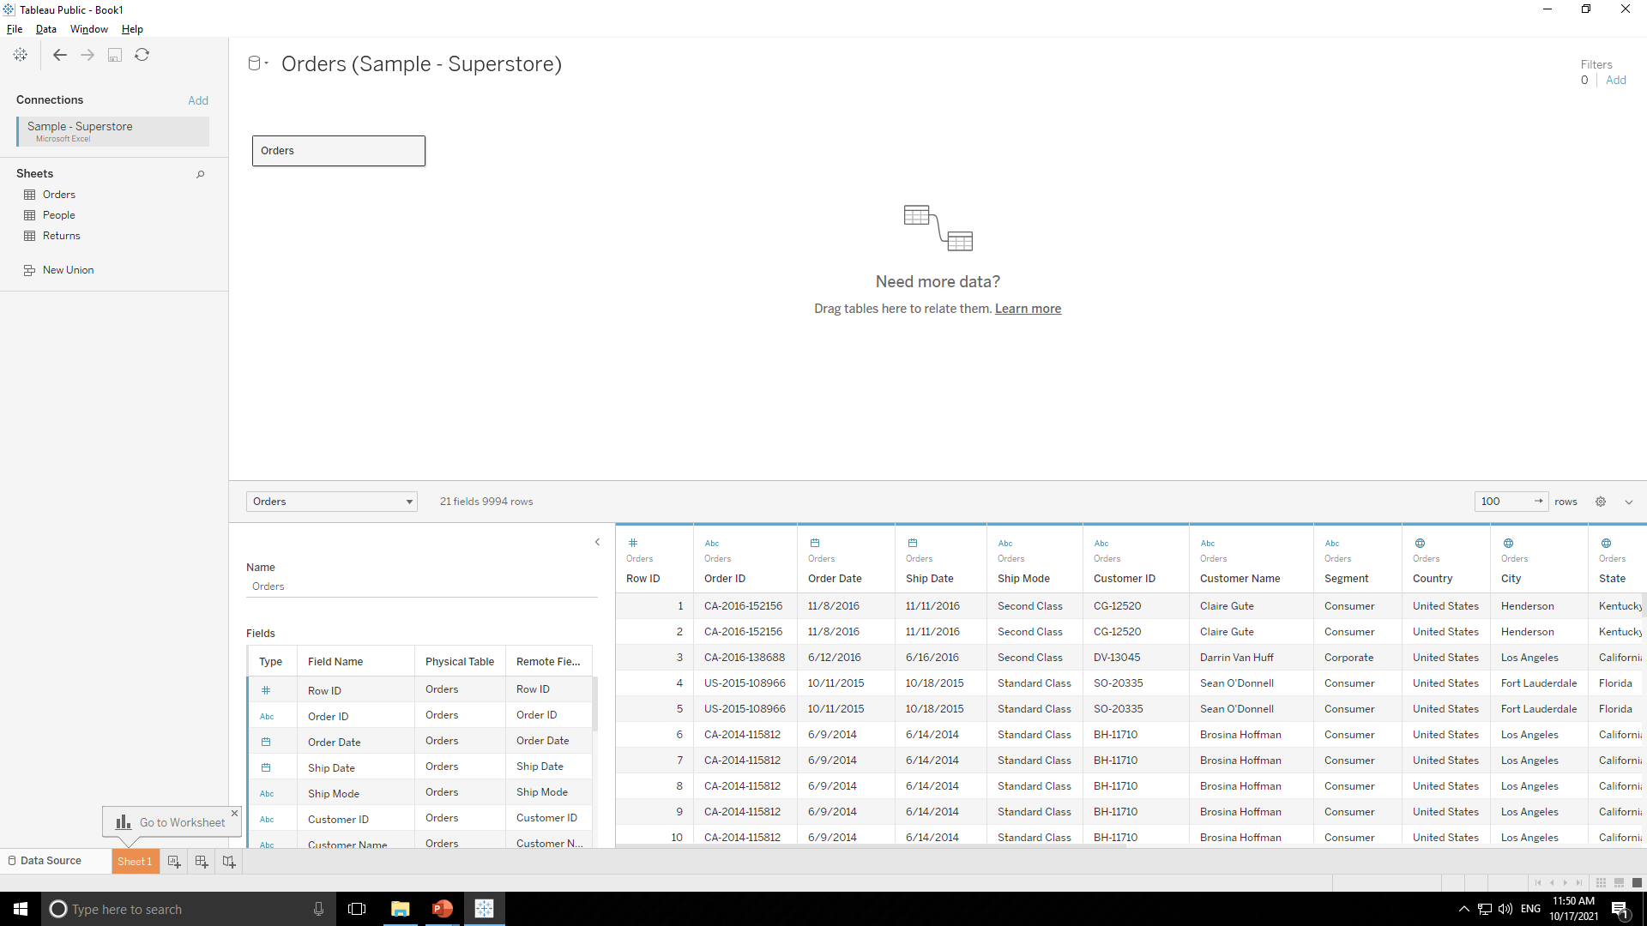
SUPERSTORE DATASOURCE
1. Find the aggregate sales for each month of a year using area chart.
For this problem statement we will use “Order” table so drag and drop that table on right side as shown below.

Slide 19
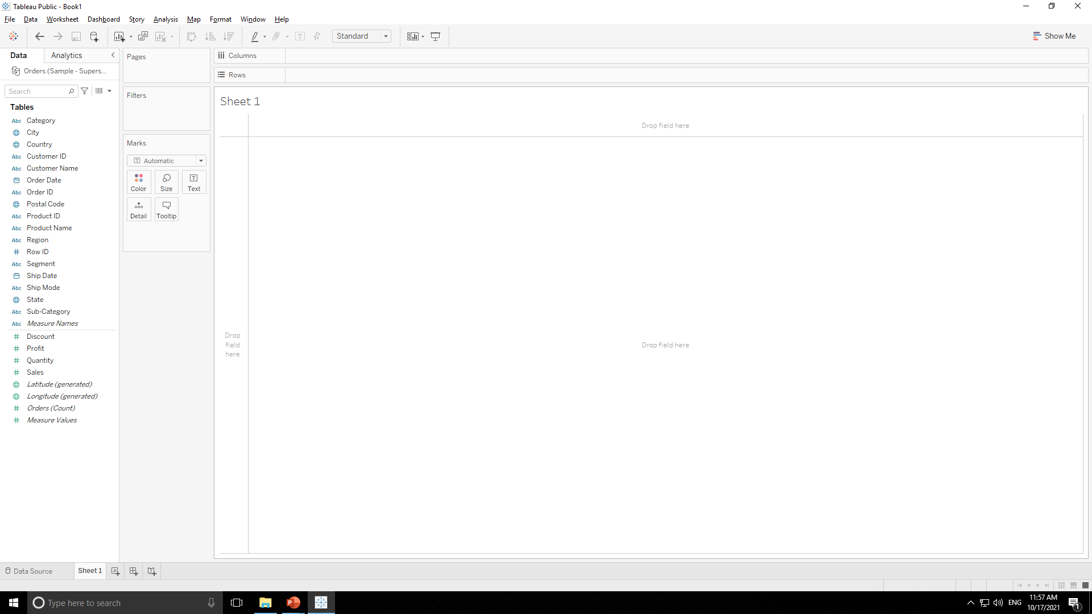
SUPERSTORE DATASOURCE
Press “Sheet 1” tab as shown below.
After pressing it we will come to below page.

Slide 20
SUPERSTORE DATASOURCE
Dimensions
Measures

Slide 21
SUPERSTORE DATASOURCE
Working Area

Slide 22
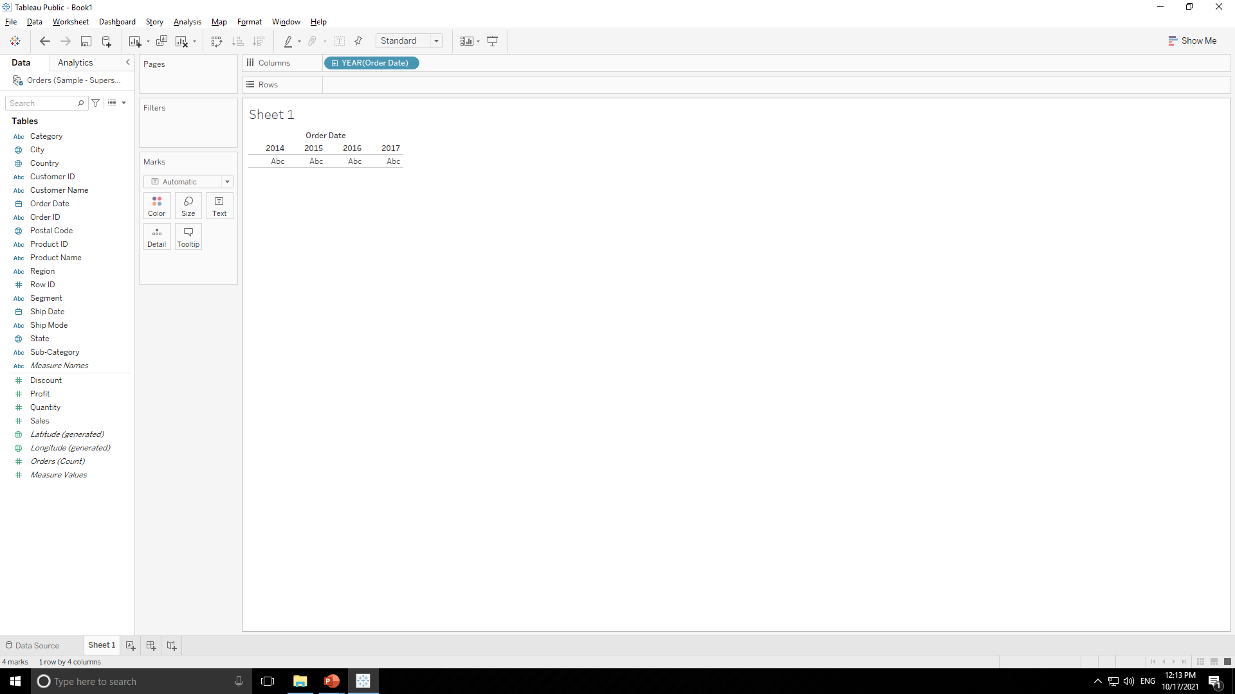
SUPERSTORE DATASOURCE
Double click on dimension “Order Date” .Tableau will automatically create appropriate chart for us as shown below.

Slide 23
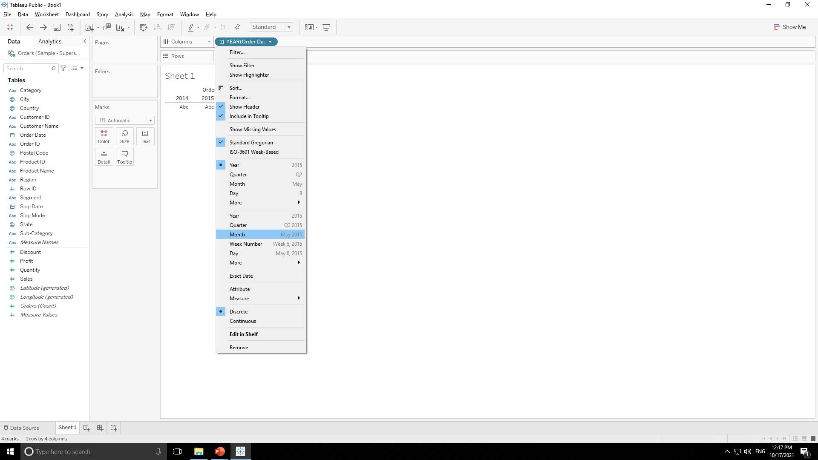
SUPERSTORE DATASOURCE
Now as per problem statement we want chart for each month of year so change years to month by clicking year tab in columns as shown below.

Slide 24
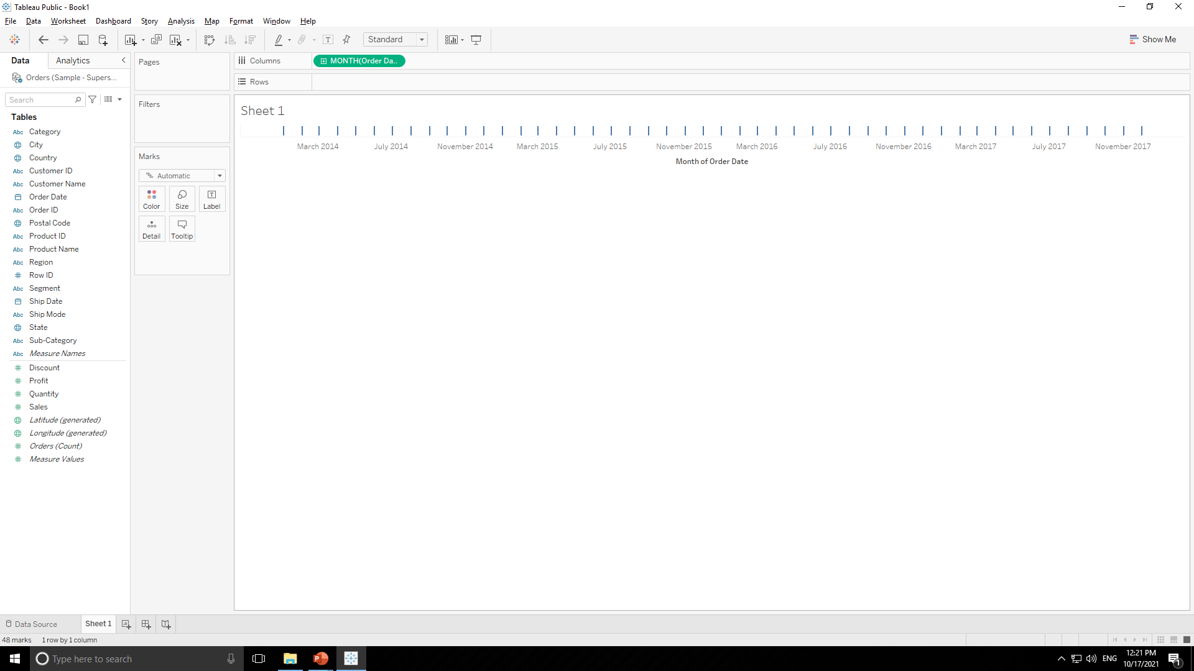
SUPERSTORE DATASOURCE

Slide 25
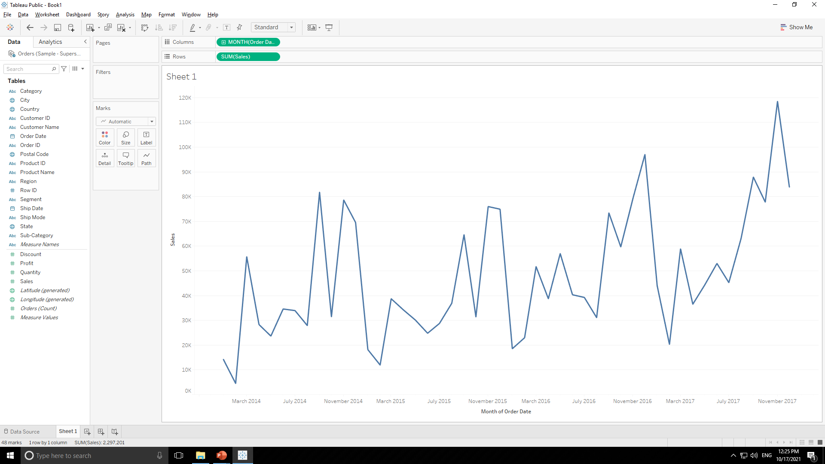
SUPERSTORE DATASOURCE
Double click on measure sales “Sales” then tableau will automatically create line chart for aggregated sales values for each month of year as shown below.

Slide 26

SUPERSTORE DATASOURCE
In “Marks” tab change automatic to area so tableau will create area chart for it as shown below.

Slide 27
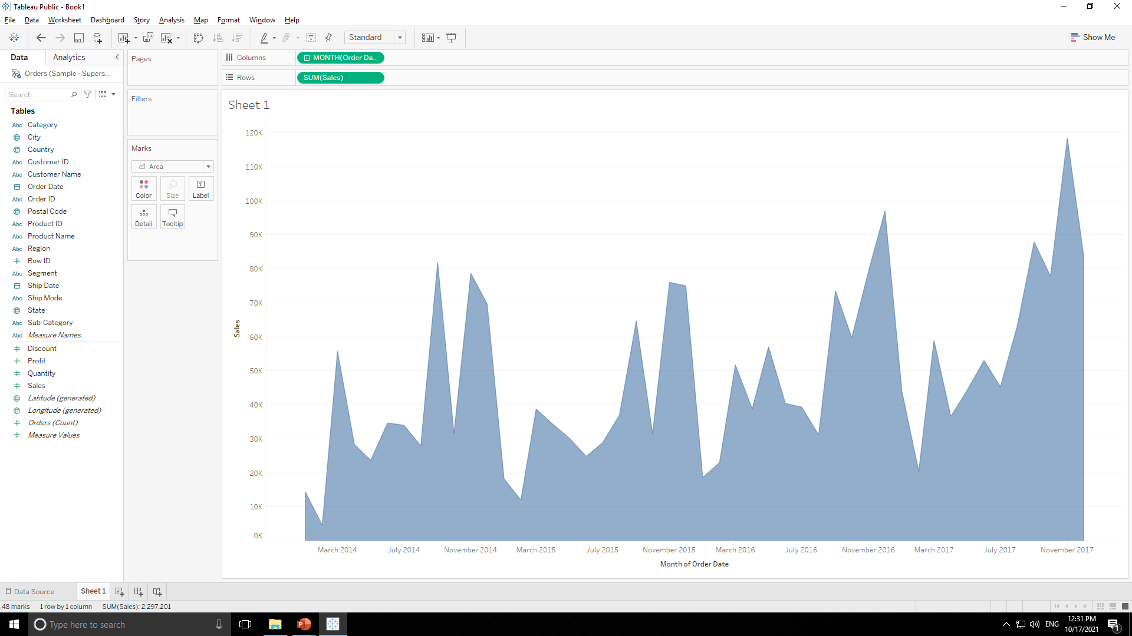
SUPERSTORE DATASOURCE

Slide 28
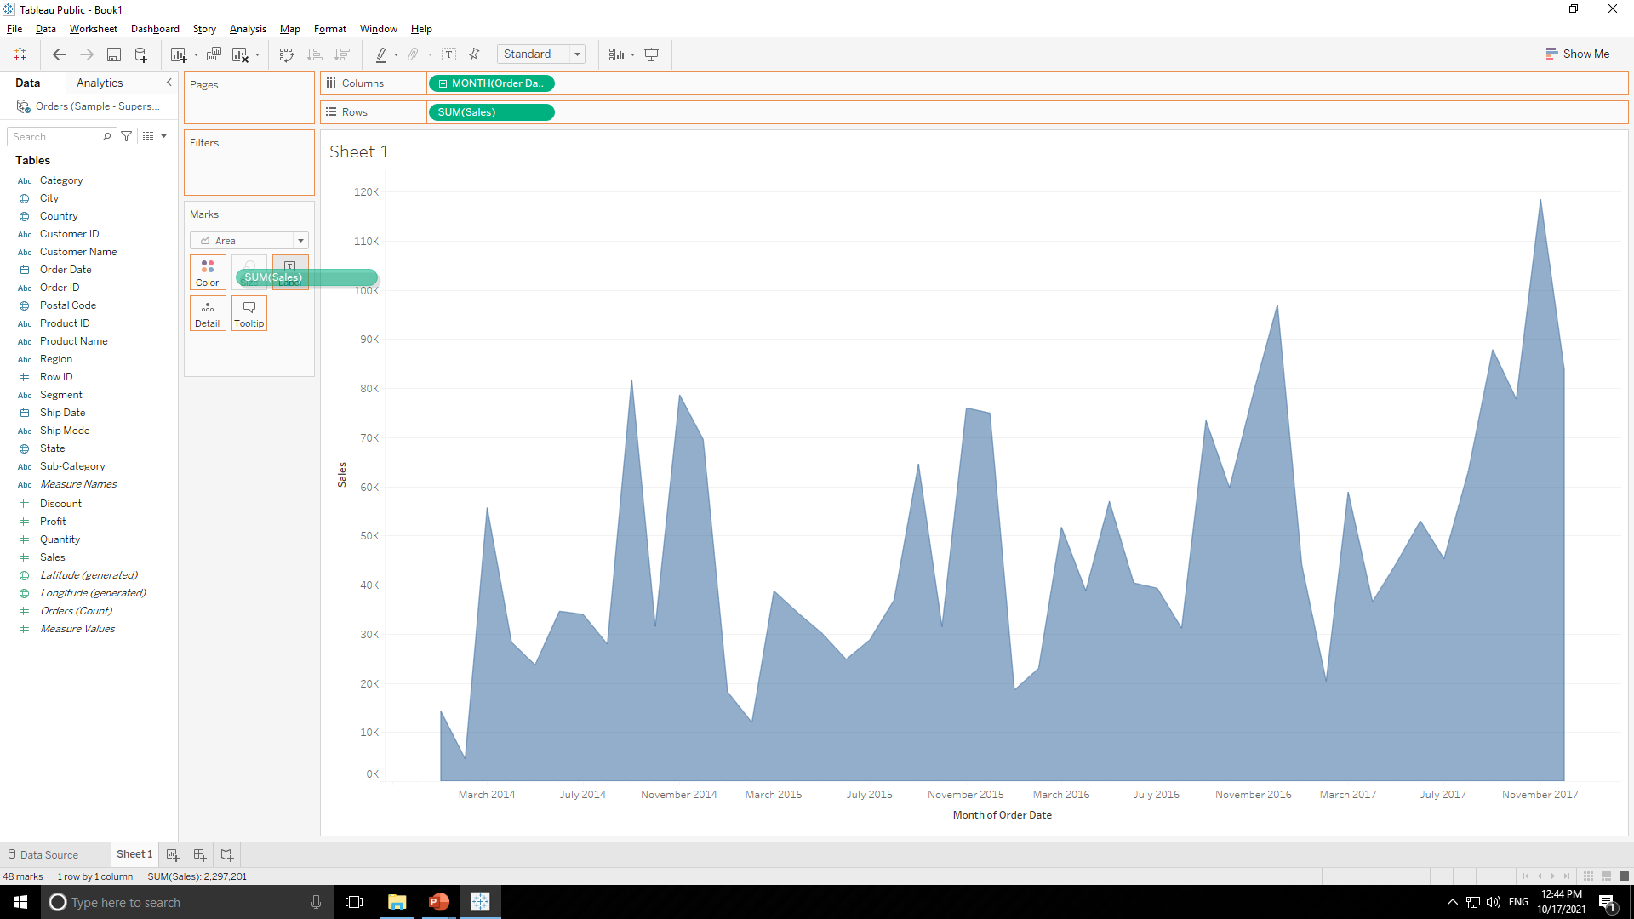
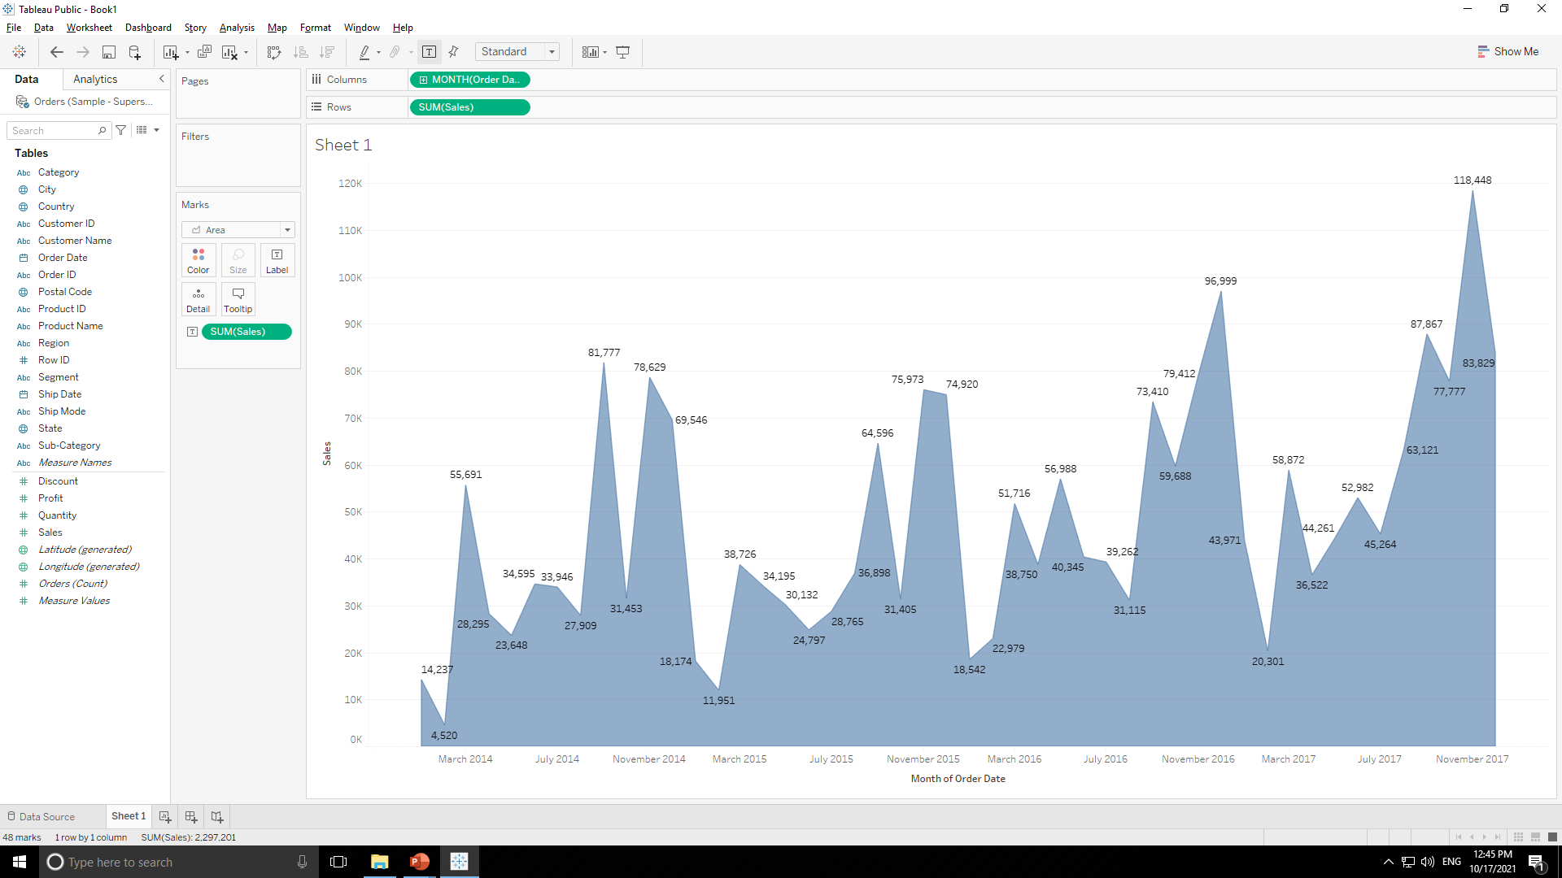
SUPERSTORE DATASOURCE
Drag & drop measure “Sales” in “Label Tab” of “Marks Tab” to get label of sales in chart as shown below.

Slide 29

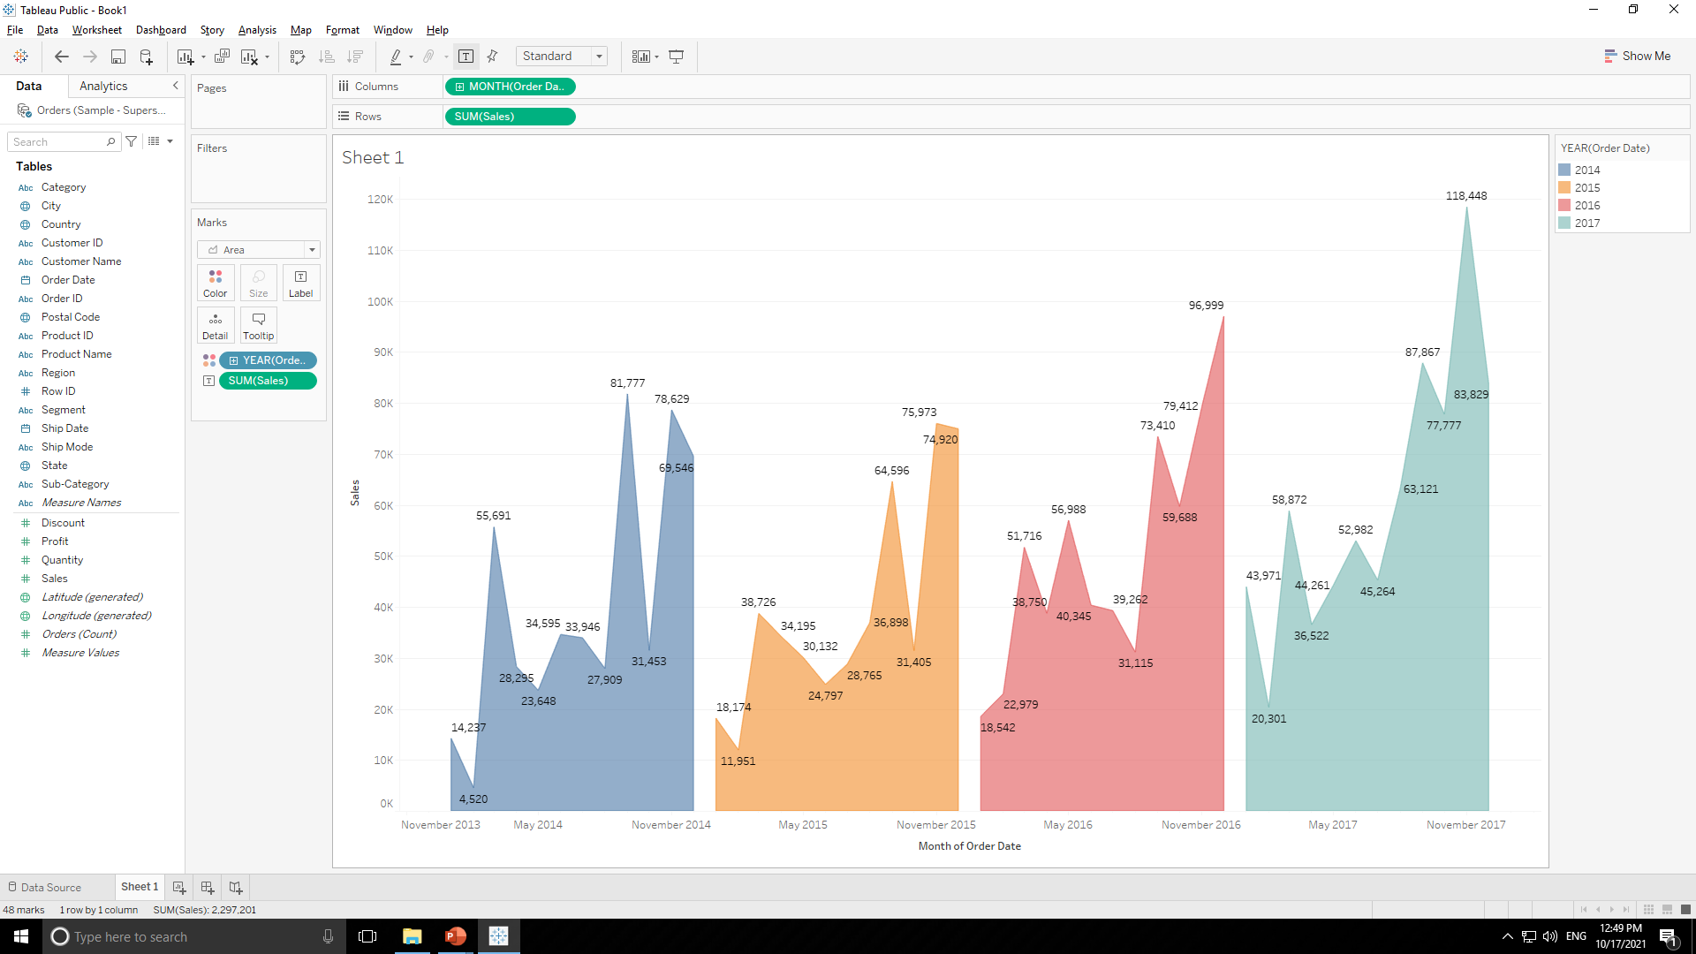
SUPERSTORE DATASOURCE
Drag & drop dimension “Order Date” in “Color Tab” of “Marks Tab” to get color in chart year wise as shown below.

Slide 30
SUPERSTORE DATASOURCE
Color Indicator i.e. which color shows which year is here as shown below.

Slide 31
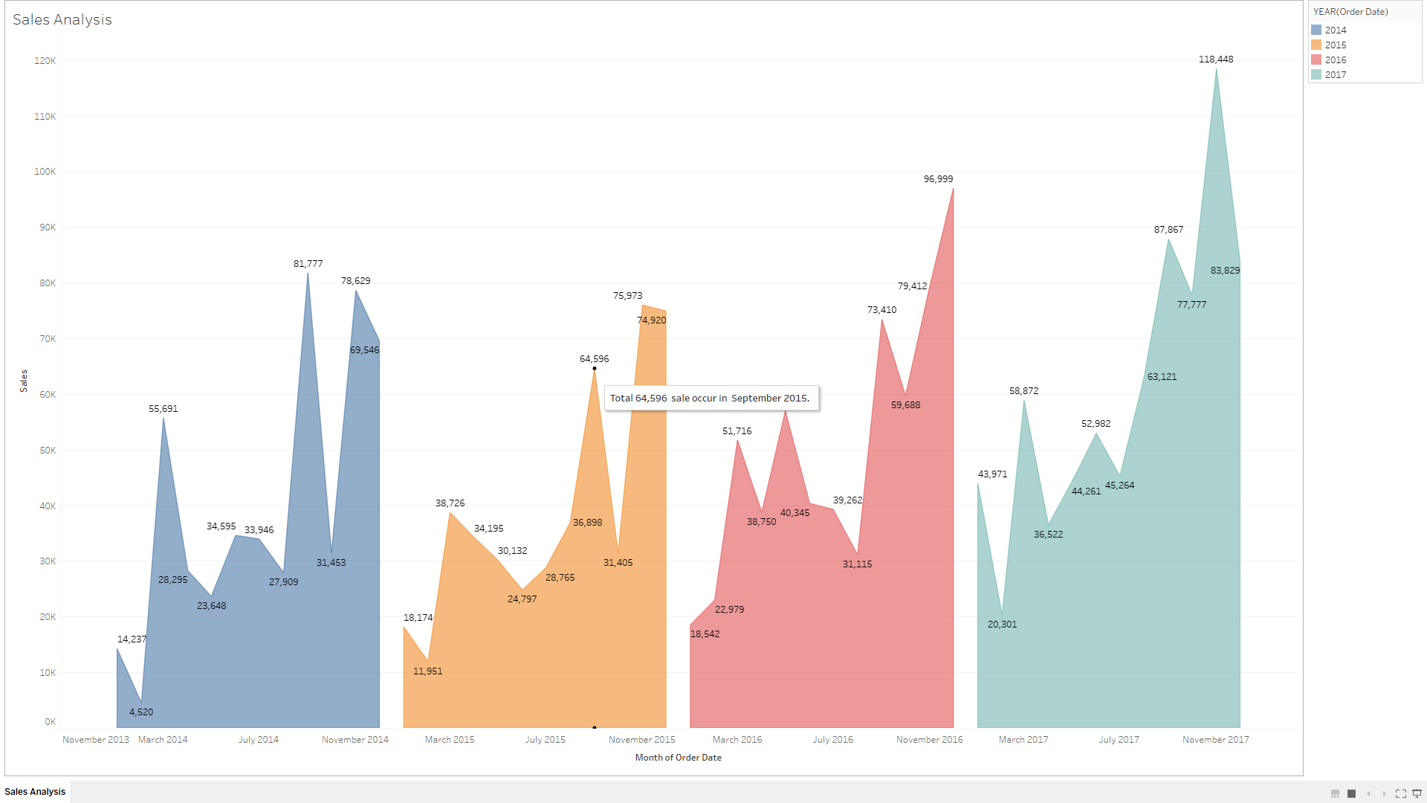
SUPERSTORE DATASOURCE
Final Output :

Slide 32
SUPERSTORE DATASOURCE
Final Output :

Slide 33
SUPERSTORE DATASOURCE
2. Find the aggregate profit for each quarter of a year 2015-2018 using area chart
For this problem statement we will use “Order” table so drag and drop that table on right side as shown below.

Slide 34
SUPERSTORE DATASOURCE
Press “Sheet 1” tab as shown below.
After pressing it we will come to below page.

Slide 35
SUPERSTORE DATASOURCE
Dimensions
Measures

Slide 36
SUPERSTORE DATASOURCE
Working Area

Slide 37
SUPERSTORE DATASOURCE
Double click on dimension “Order Date” .Tableau will automatically create appropriate chart for us as shown below.

Slide 38
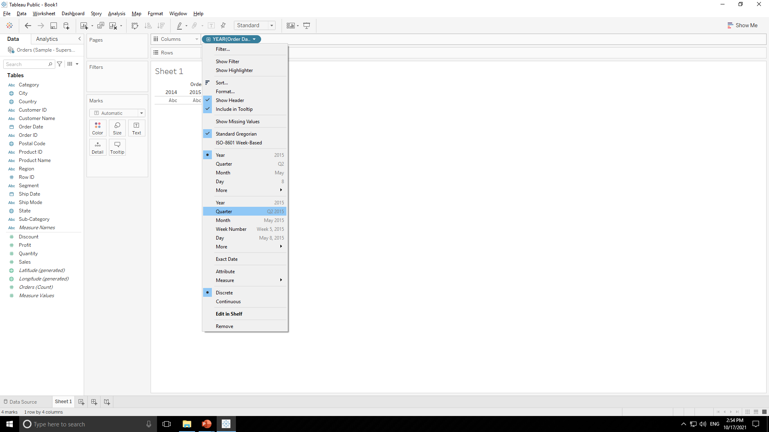
SUPERSTORE DATASOURCE
Now as per problem statement we want chart for each quarter of a year so change years to quarter by clicking year tab in columns as shown below.

Slide 39

SUPERSTORE DATASOURCE

Slide 40
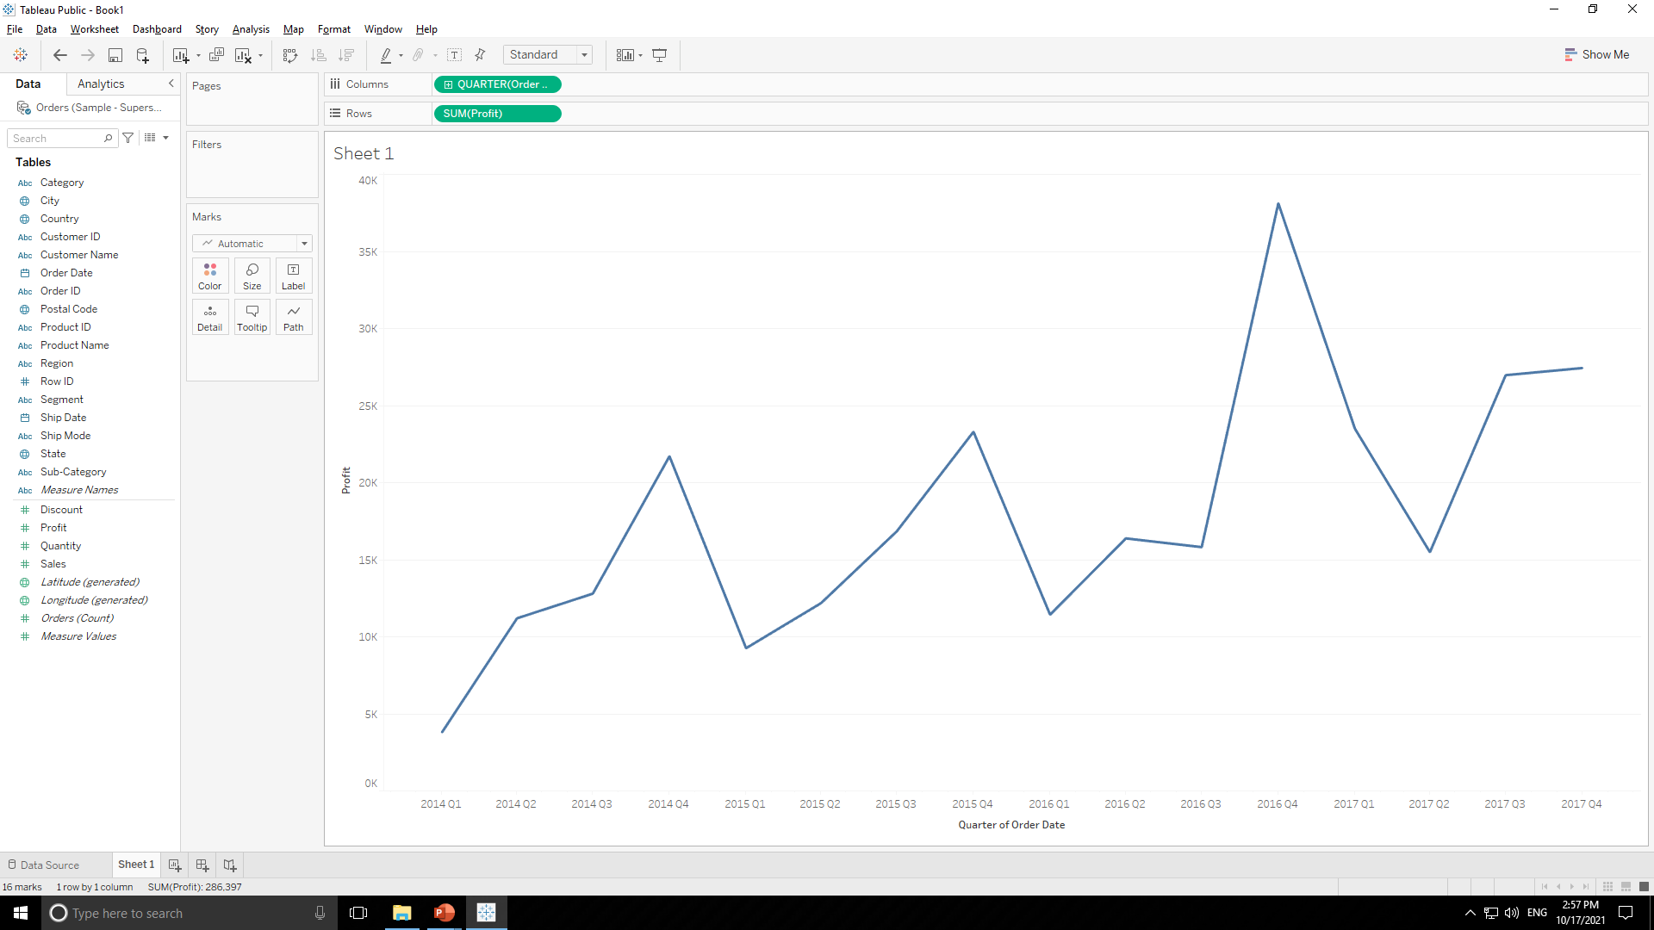
SUPERSTORE DATASOURCE
Double click on measure sales “Profit” then tableau will automatically create line chart for aggregated profit values for each quarter of year as shown below.

Slide 41
SUPERSTORE DATASOURCE
In “Marks” tab change automatic to area so tableau will create area chart for it as shown below.

Slide 42
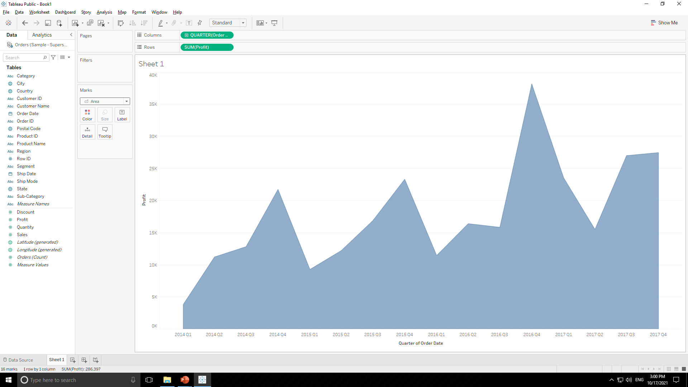
SUPERSTORE DATASOURCE

Slide 43
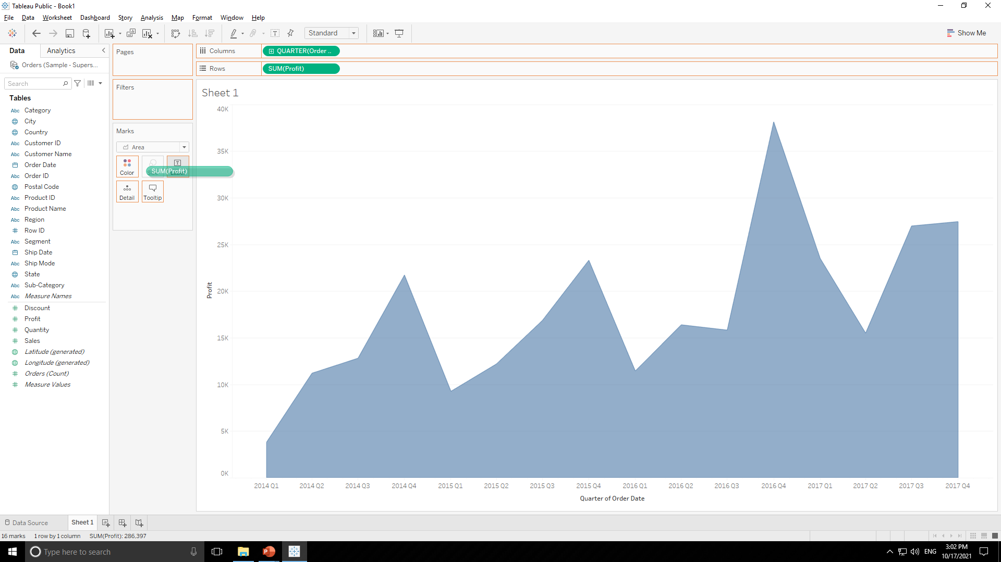
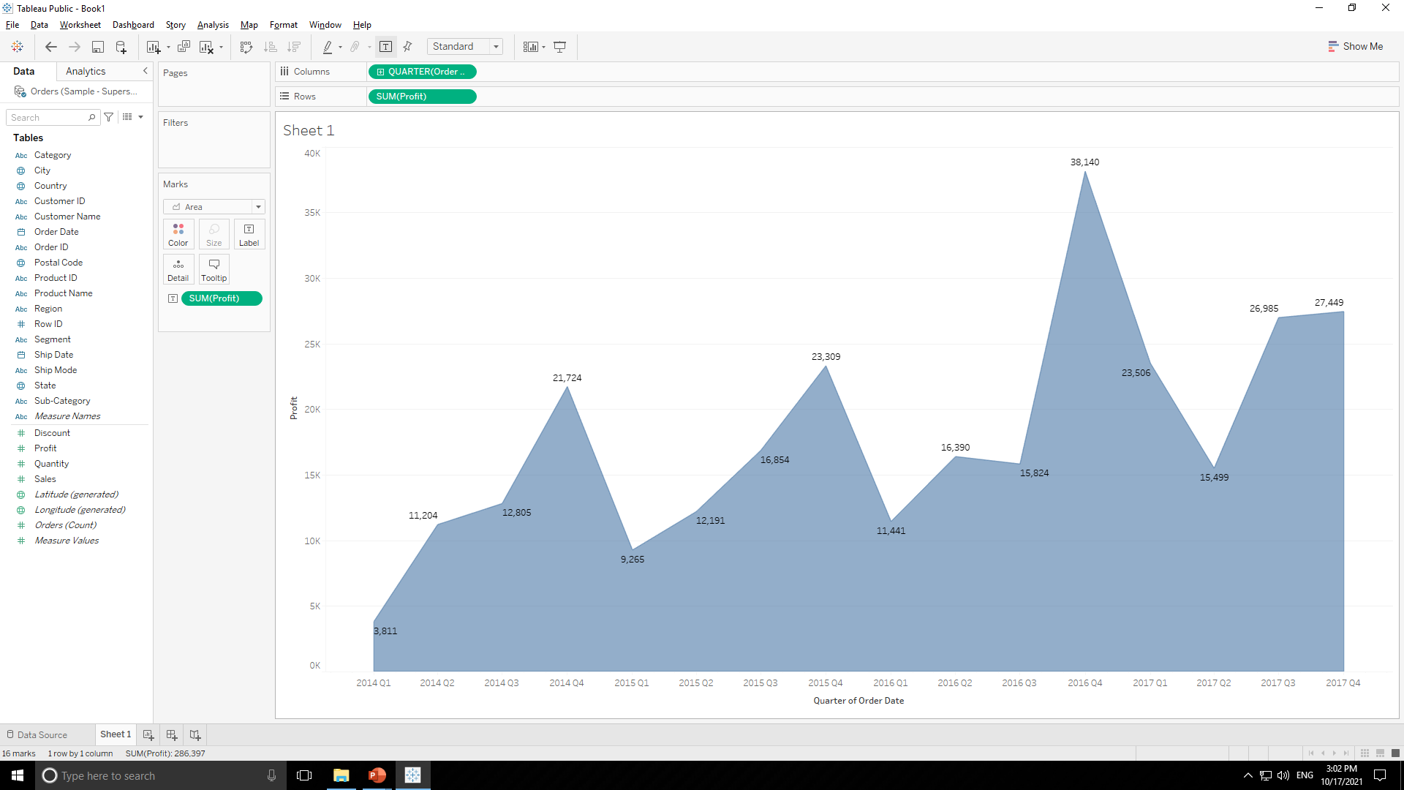
SUPERSTORE DATASOURCE
Drag & drop measure “Profit” in “Label Tab” of “Marks Tab” to get label of profit in chart as shown below.

Slide 44

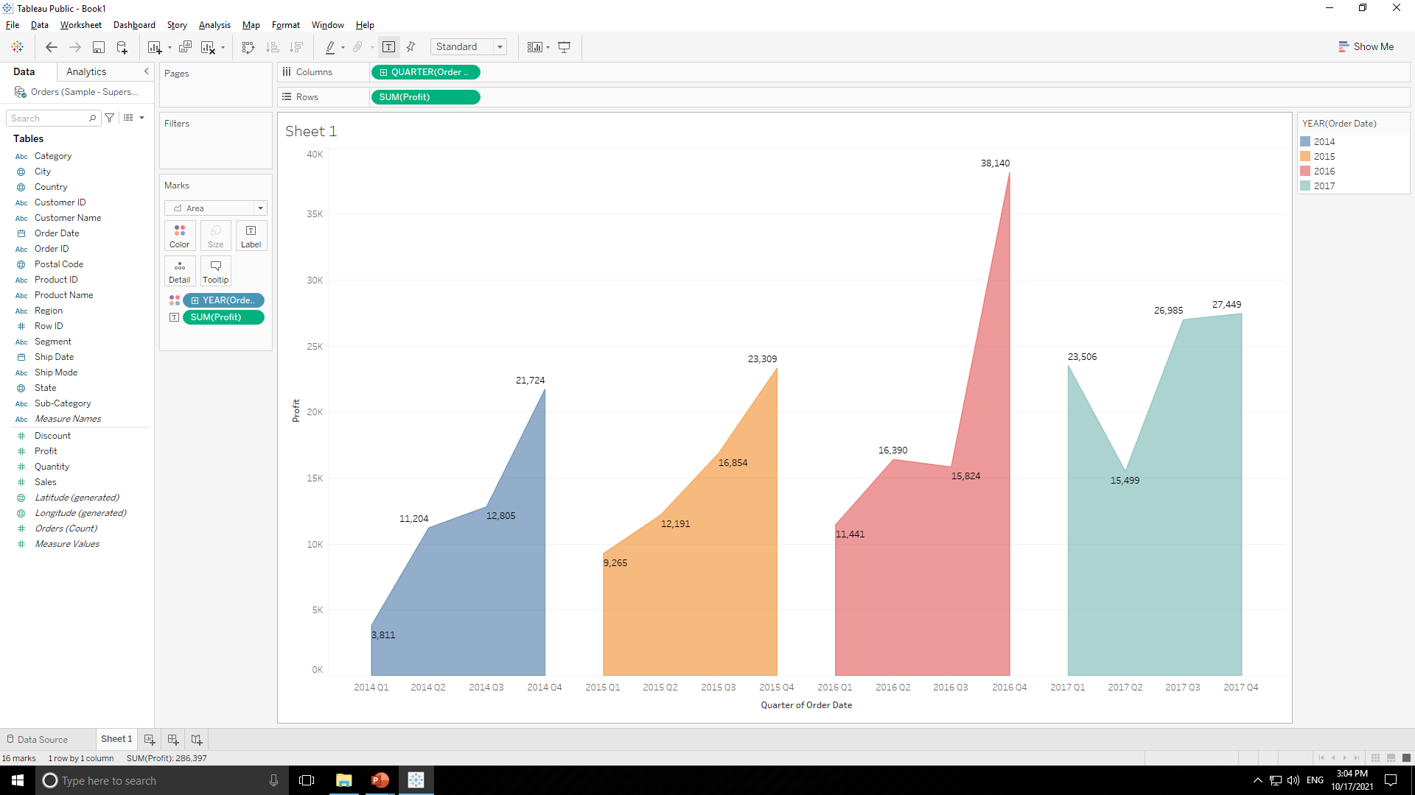
SUPERSTORE DATASOURCE
Drag & drop dimension “Order Date” in “Color Tab” of “Marks Tab” to get color in chart year wise as shown below.

Slide 45
SUPERSTORE DATASOURCE
Color Indicator i.e. which color shows which year is here as shown below.

Slide 46

SUPERSTORE DATASOURCE
Final Output :

Slide 47
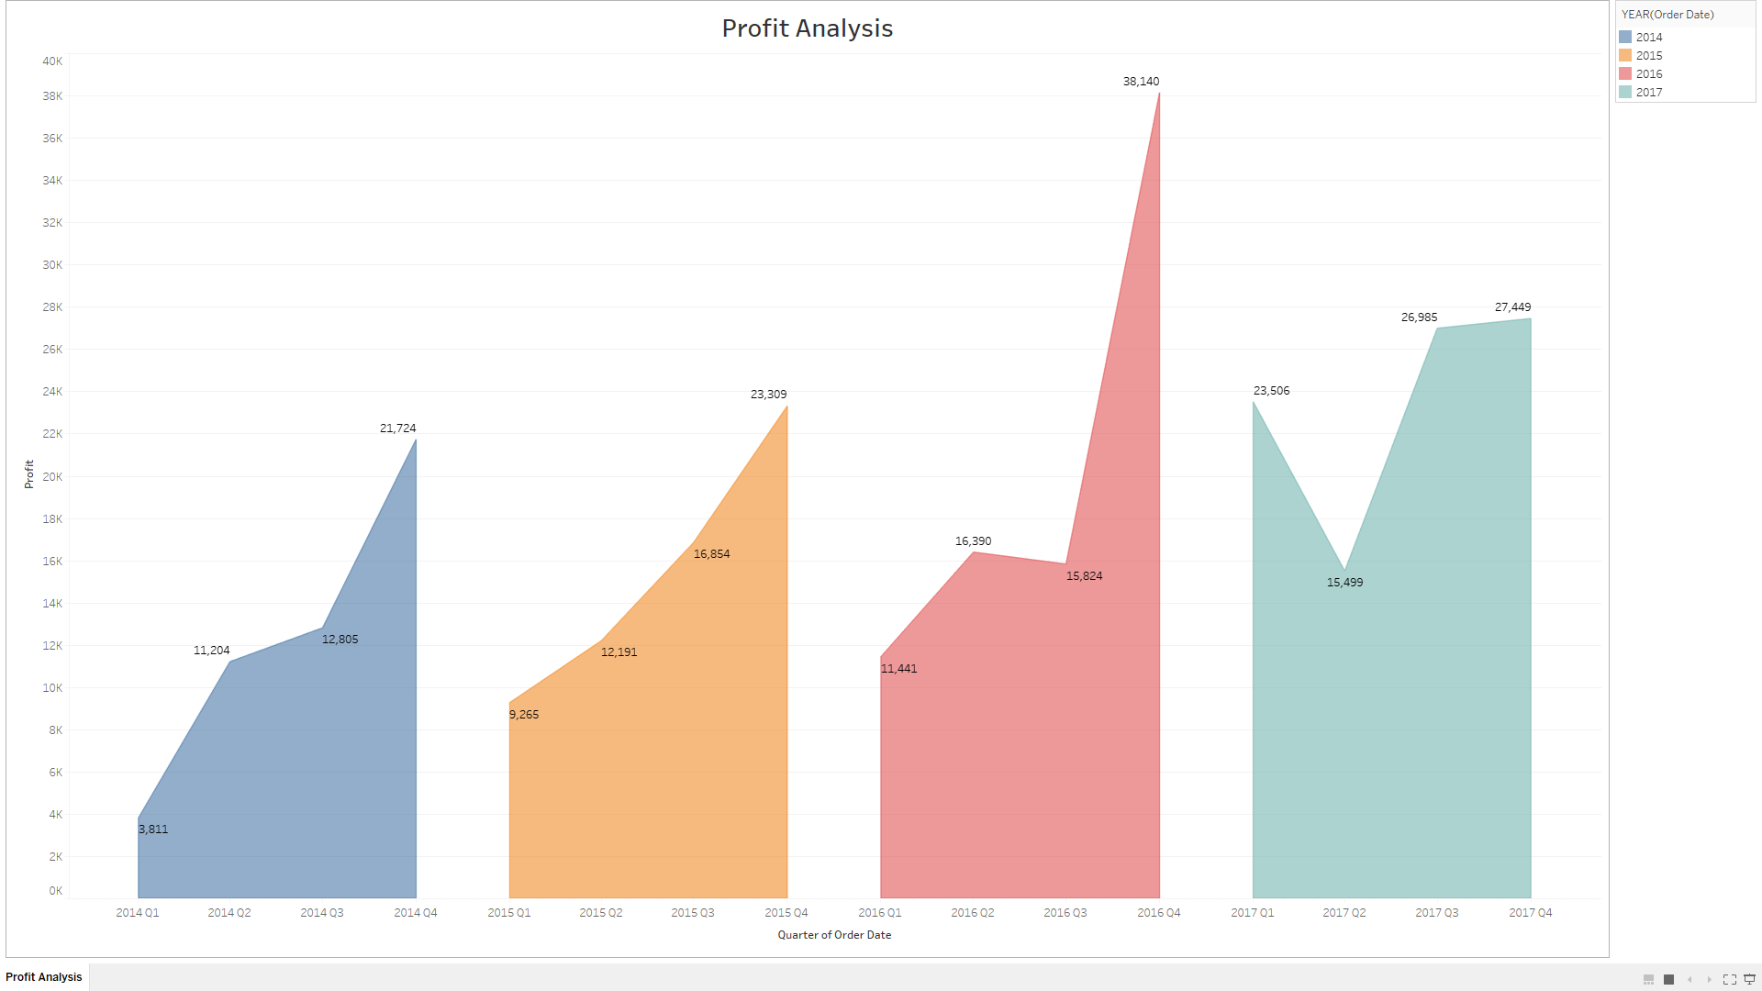
SUPERSTORE DATASOURCE
Final Output :

Slide 48
SUPERSTORE DATASOURCE
3. Plot sales and profit for each month of a year in furniture category
For this problem statement we will use “Order” table so drag and drop that table on right side as shown below.

Slide 49
SUPERSTORE DATASOURCE
Press “Sheet 1” tab as shown below.
After pressing it we will come to below page.

Slide 50
SUPERSTORE DATASOURCE
Dimensions
Measures

Slide 51
SUPERSTORE DATASOURCE
Working Area

Slide 52
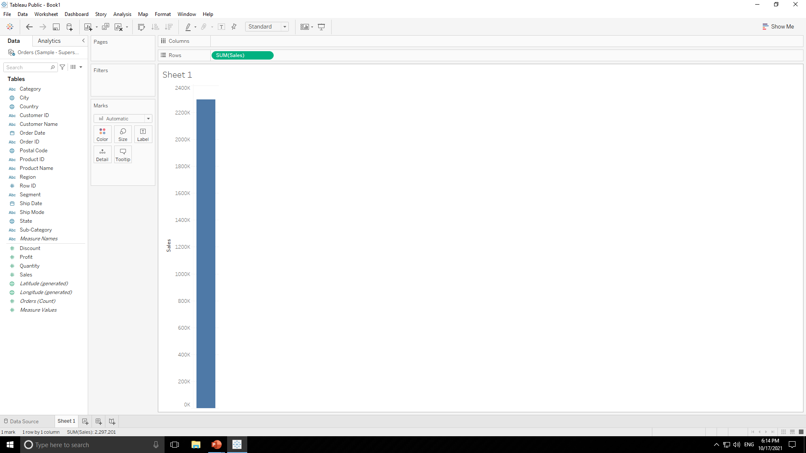
SUPERSTORE DATASOURCE
Double click on measure “Sales” .Tableau will automatically create appropriate chart for us as shown below.

Slide 53
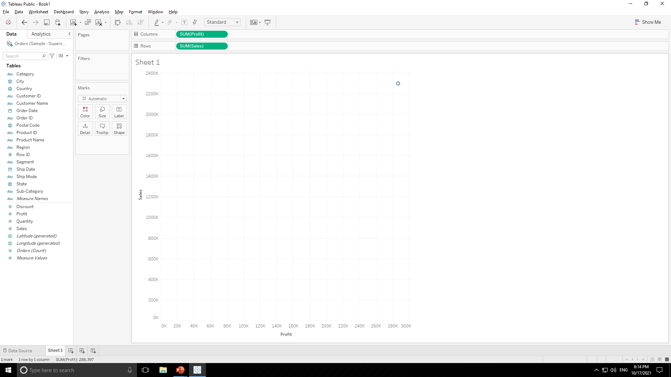
SUPERSTORE DATASOURCE
Now double click on measure “Profit” .Tableau will automatically create appropriate chart for us as shown below.

Slide 54
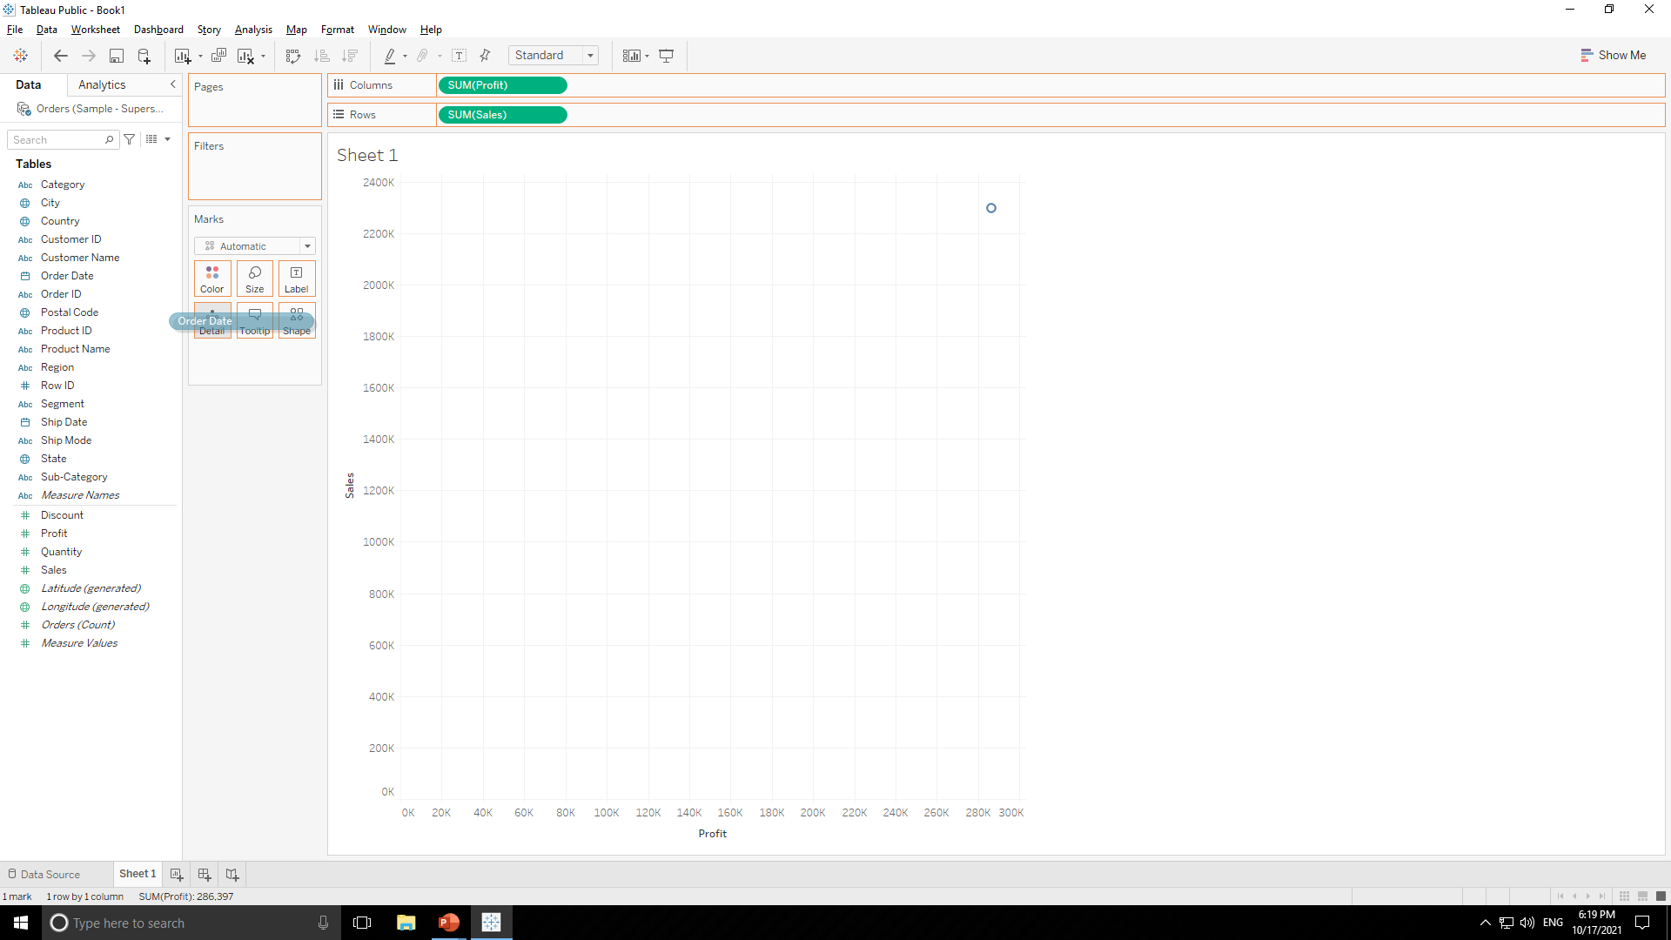
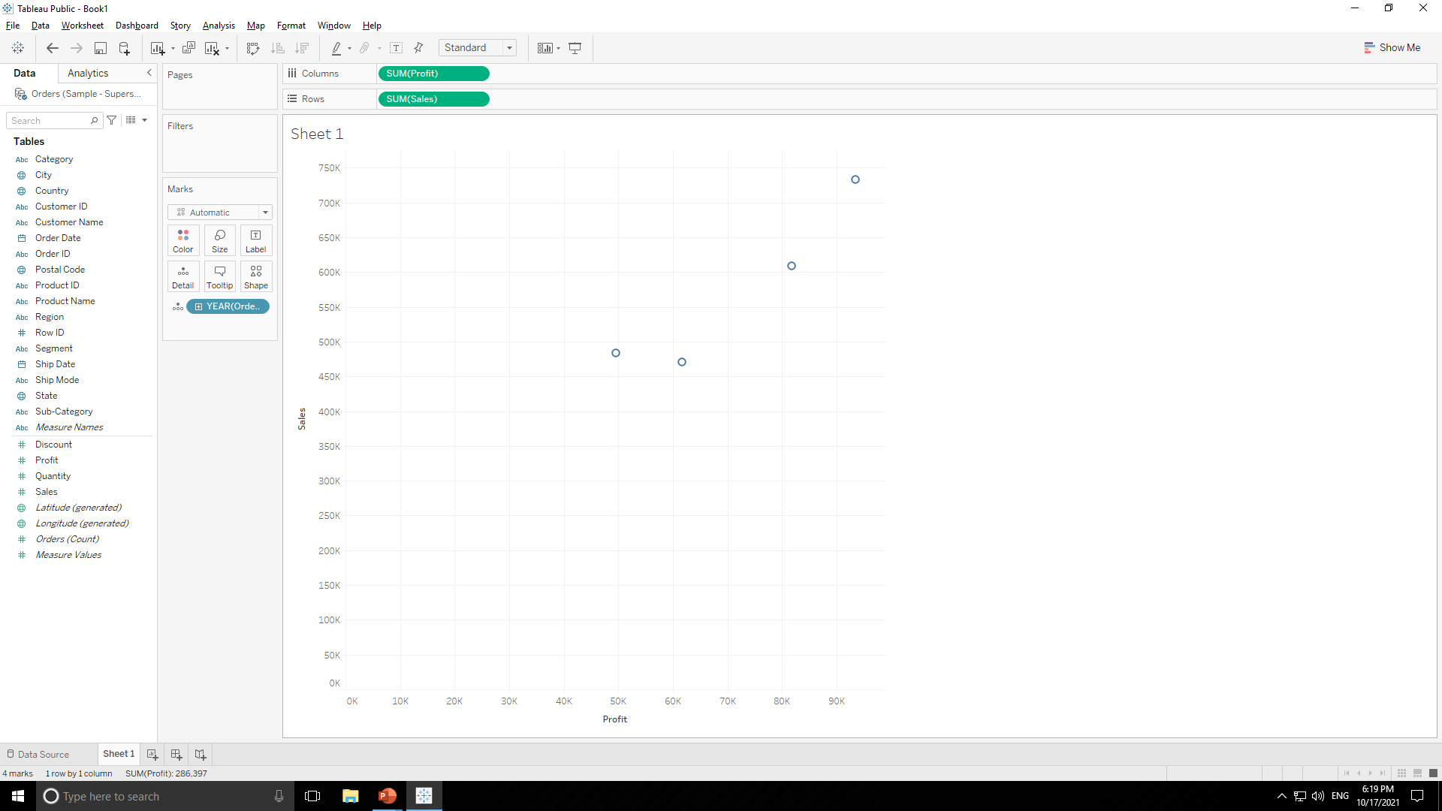
SUPERSTORE DATASOURCE
Now this graph is of aggregated values so drag & drop “Order Date” in “Detail Tab ” of “Marks Tab”.

Slide 55
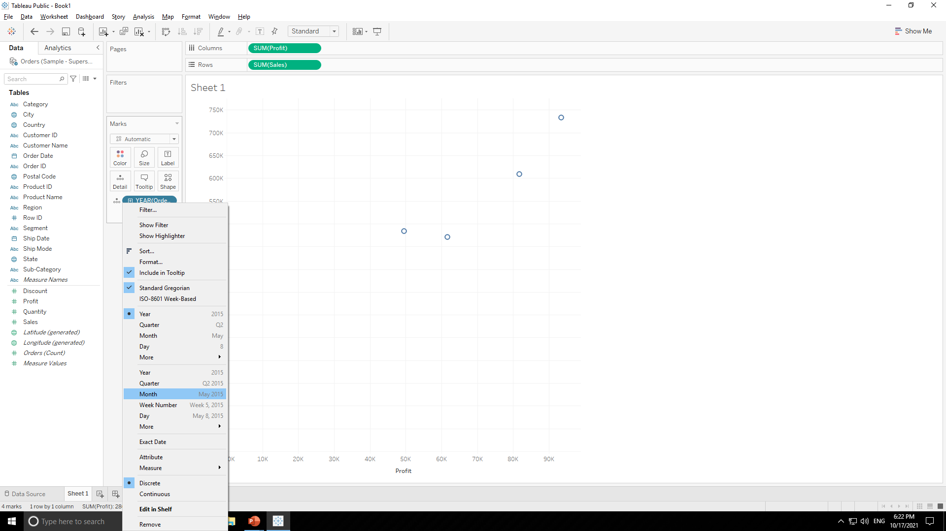
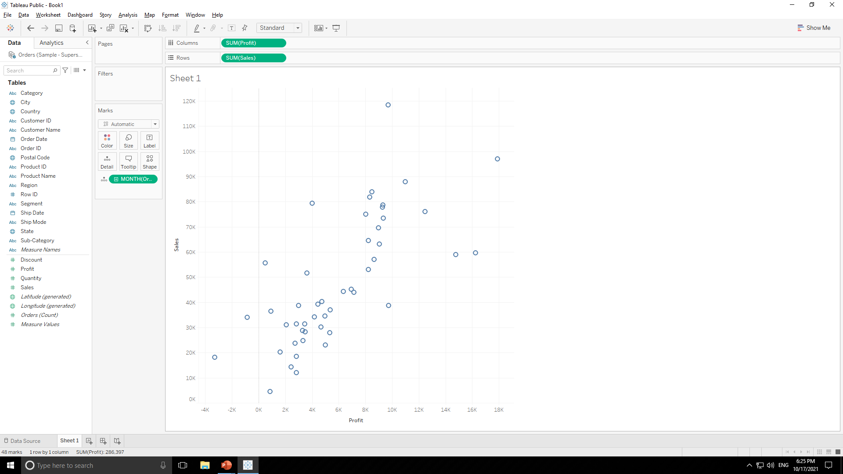
SUPERSTORE DATASOURCE
Now this graph is year wise so change granularity to month wise as shown above.

Slide 56
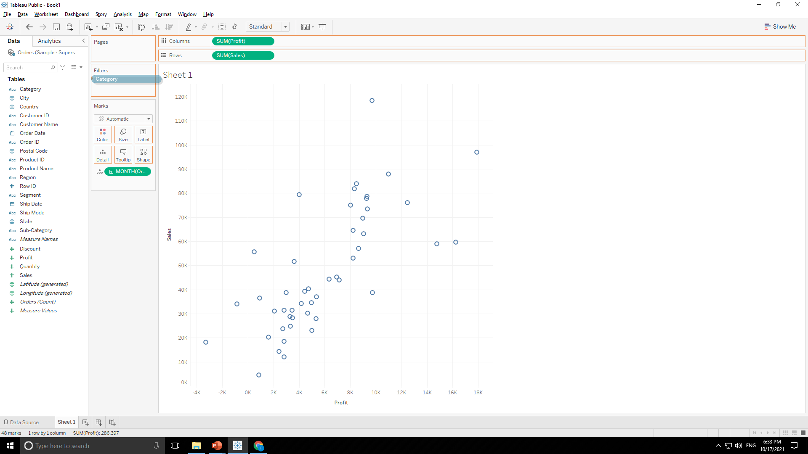
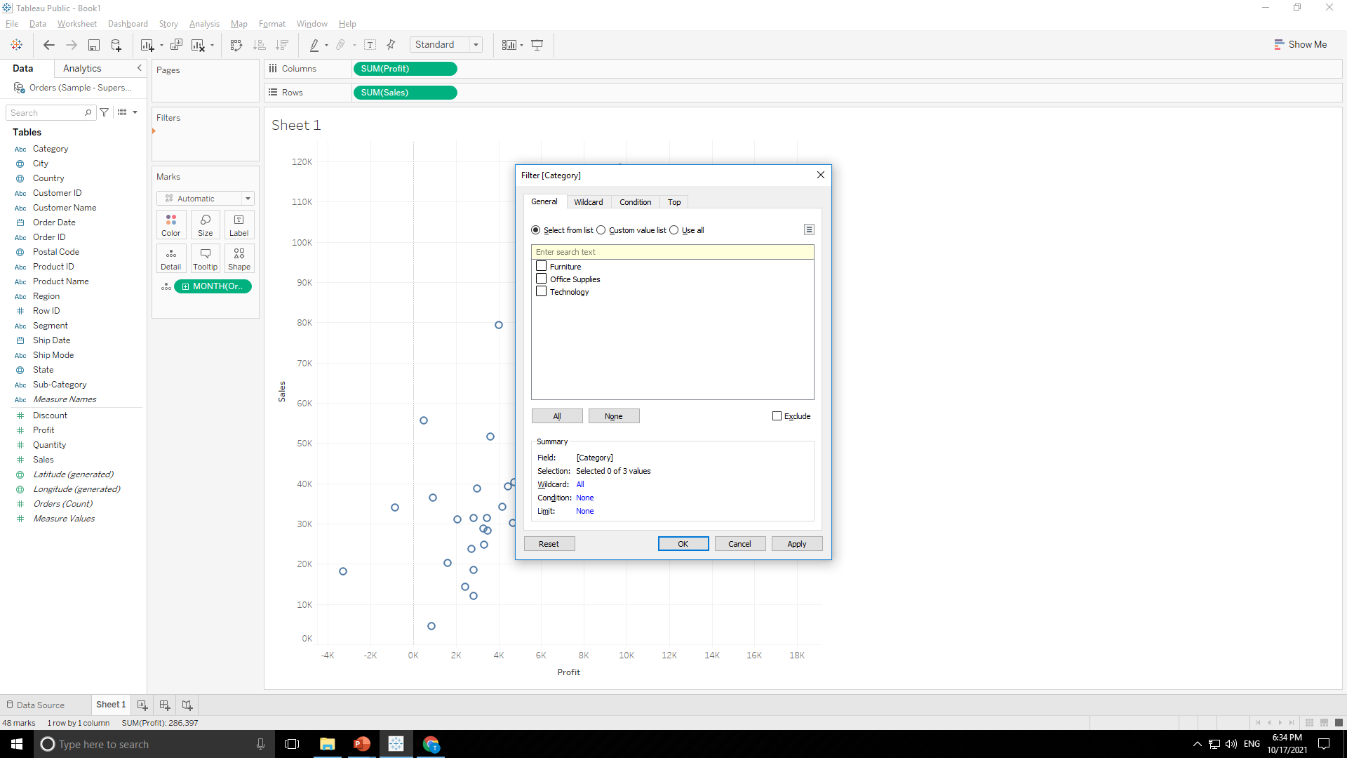
SUPERSTORE DATASOURCE
Now this graph is for all category so drag & drop “Category” in “Filter Tab” to filter it.

Slide 57
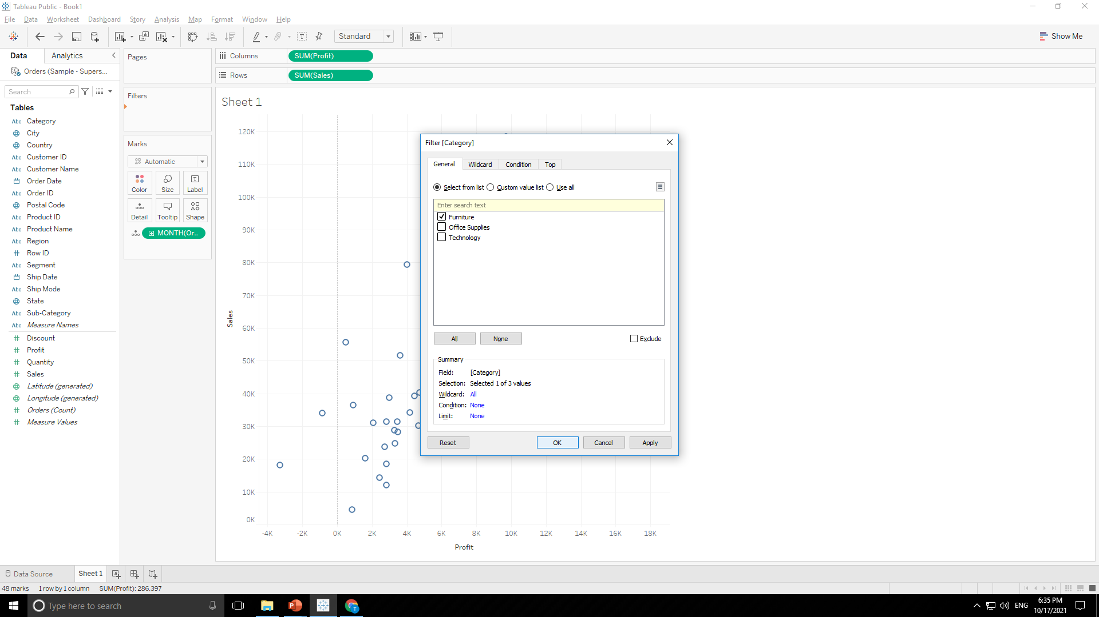
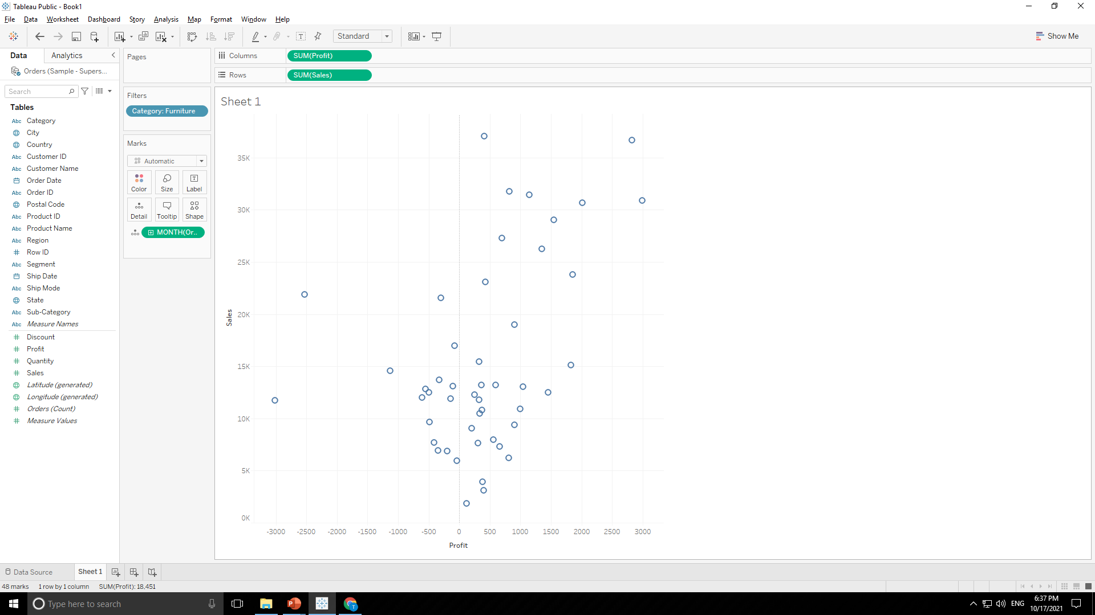
SUPERSTORE DATASOURCE
Tick on ‘Furniture’ in popup and press OK to filter graph by category as shown below.

Slide 58
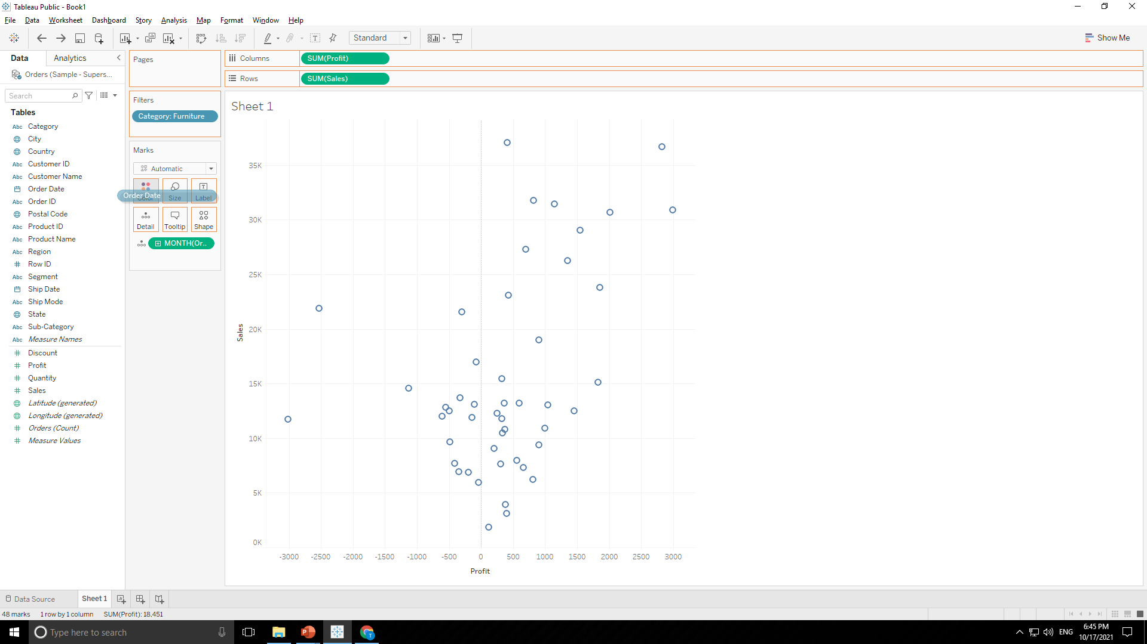
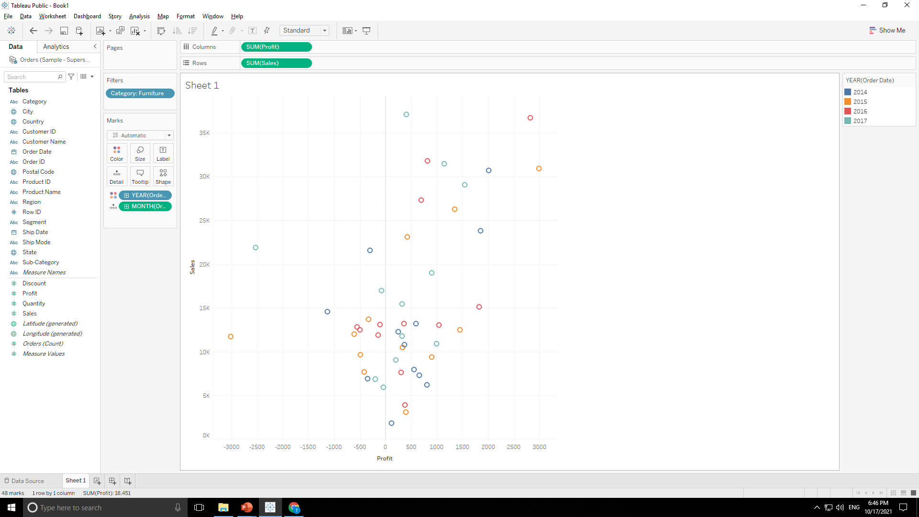
SUPERSTORE DATASOURCE
Now drag & drop “Order Date” in “Color Tab ” of “Marks Tab” to get color in chart year wise as shown below.

Slide 59
SUPERSTORE DATASOURCE
Color Indicator i.e. which color shows which year is here as shown below.

Slide 60
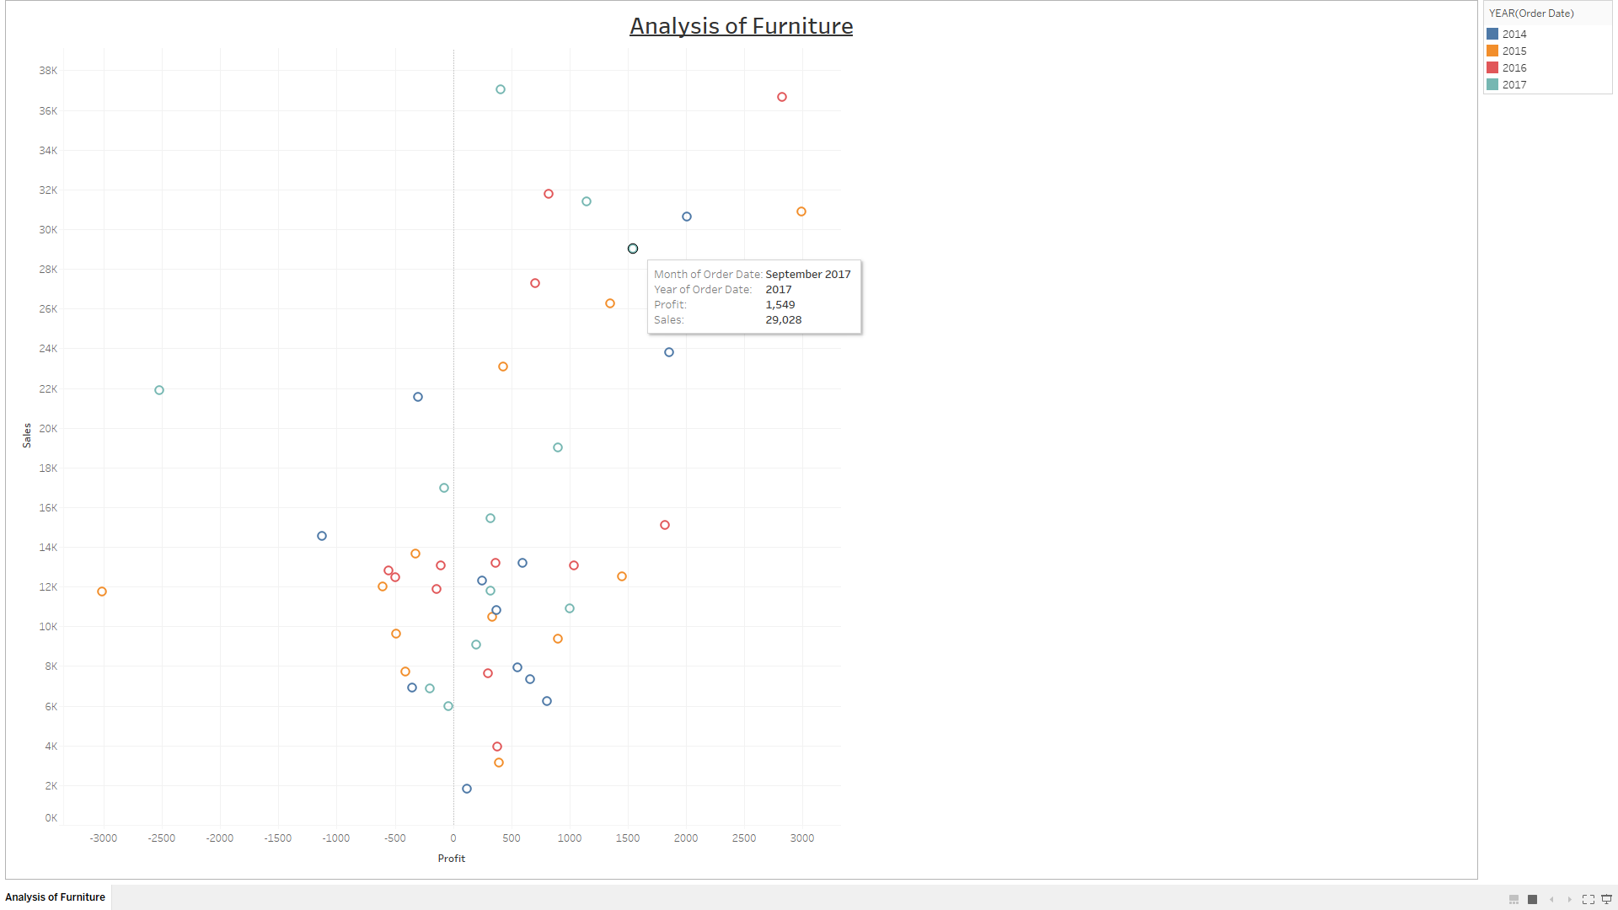
SUPERSTORE DATASOURCE
Final Output :

Slide 61
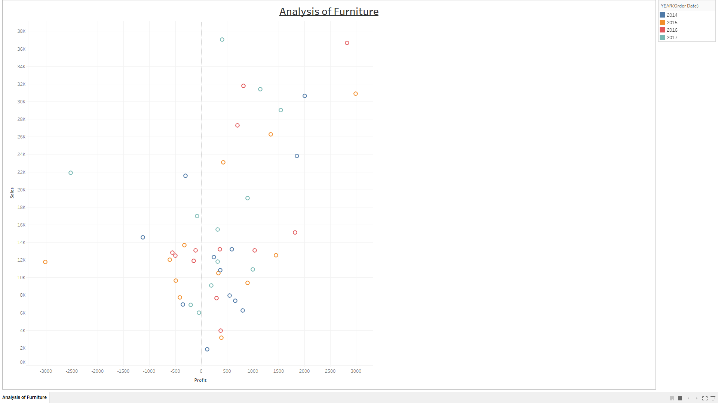
SUPERSTORE DATASOURCE
Final Output :

Slide 62
SUPERSTORE DATASOURCE
4. Plot sales and profit for each month of a year in office supplies category in central region
For this problem follow same steps as in Problem-02 upto chart as shown below.

Slide 63
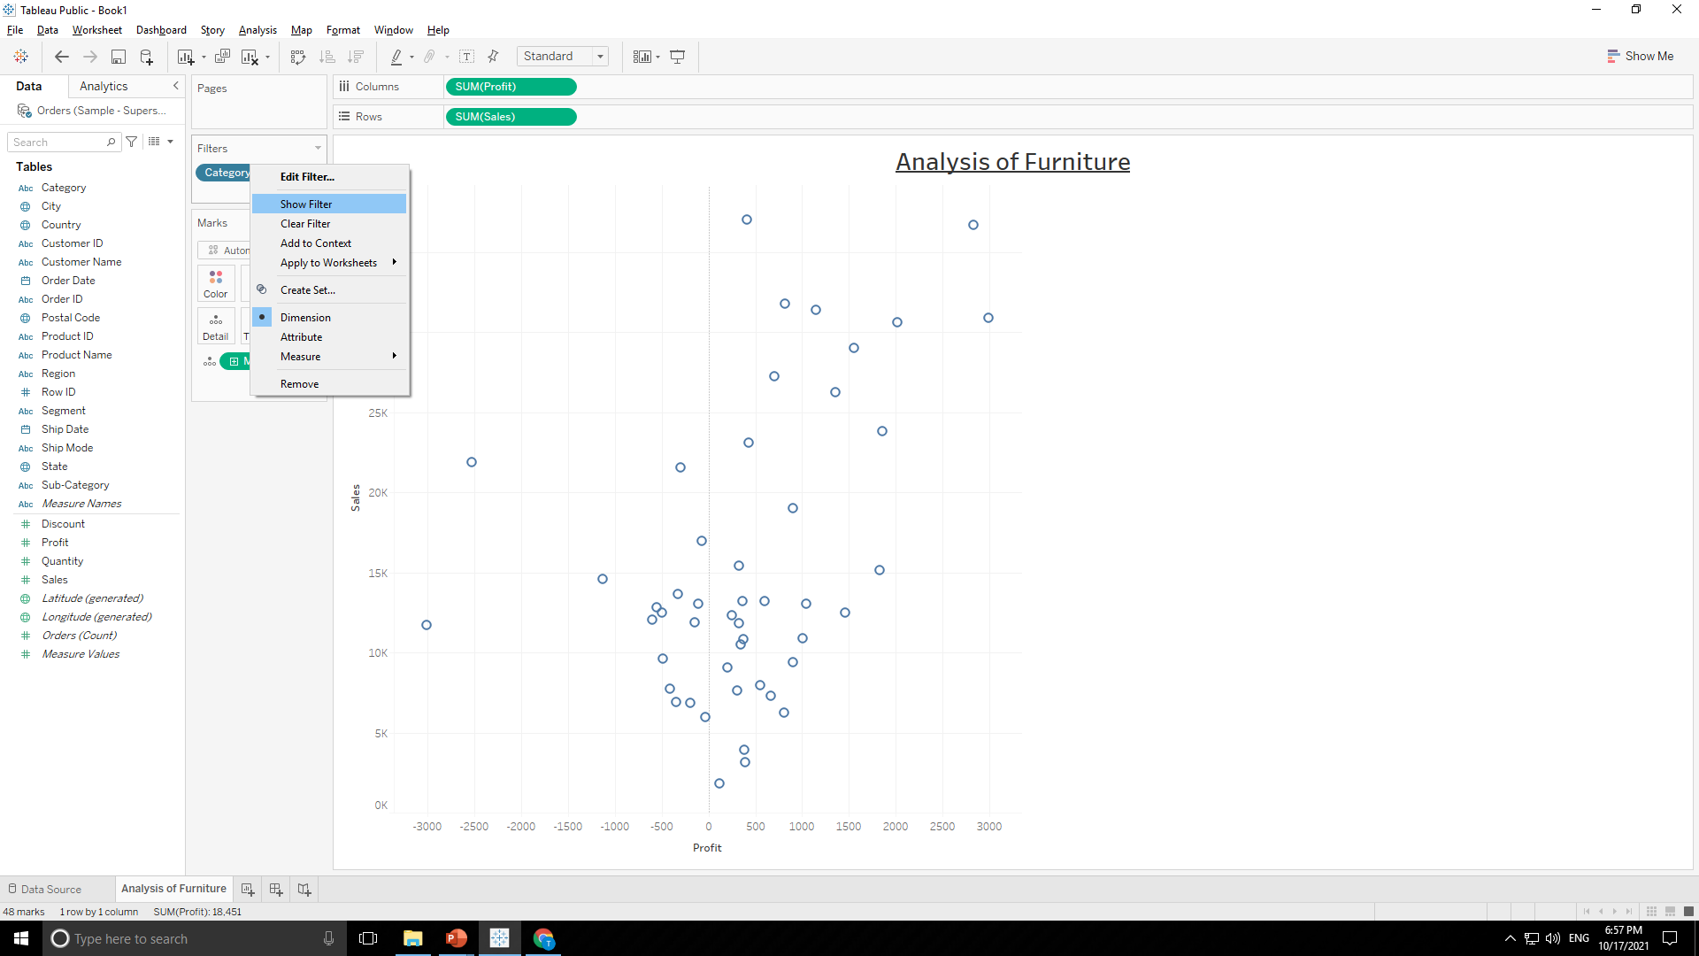
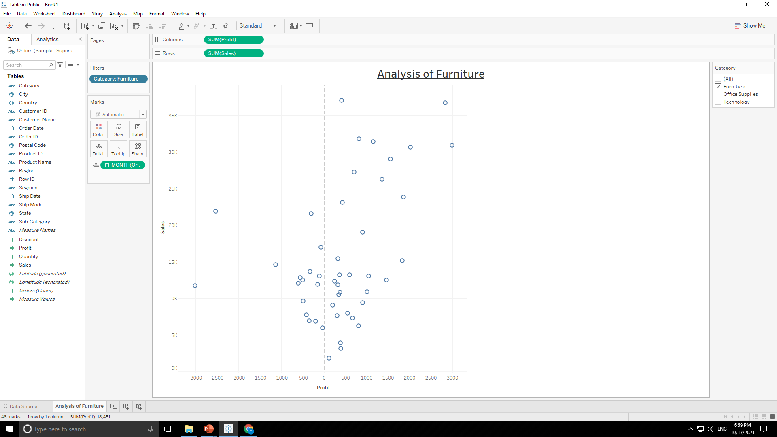
SUPERSTORE DATASOURCE
Now left click on category in “Filter Tab” and press “Show filter”.

Slide 64
SUPERSTORE DATASOURCE
Now “Category tab” will be added into screen.

Slide 65
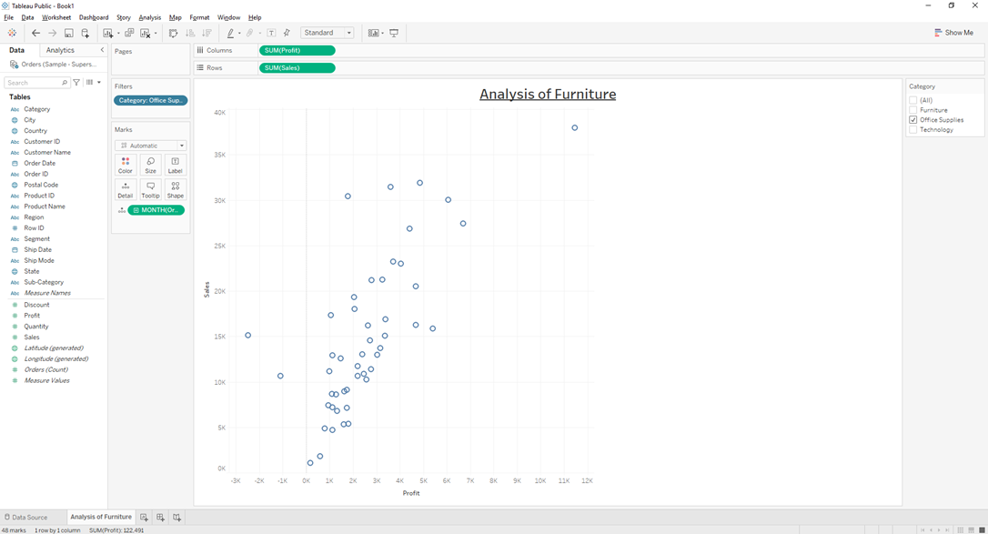
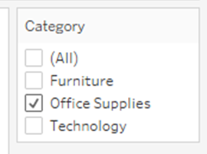
SUPERSTORE DATASOURCE
Tick on “Office Supplies” in “Category Tab” in order to get graph of that particular category as shown below.

Slide 66
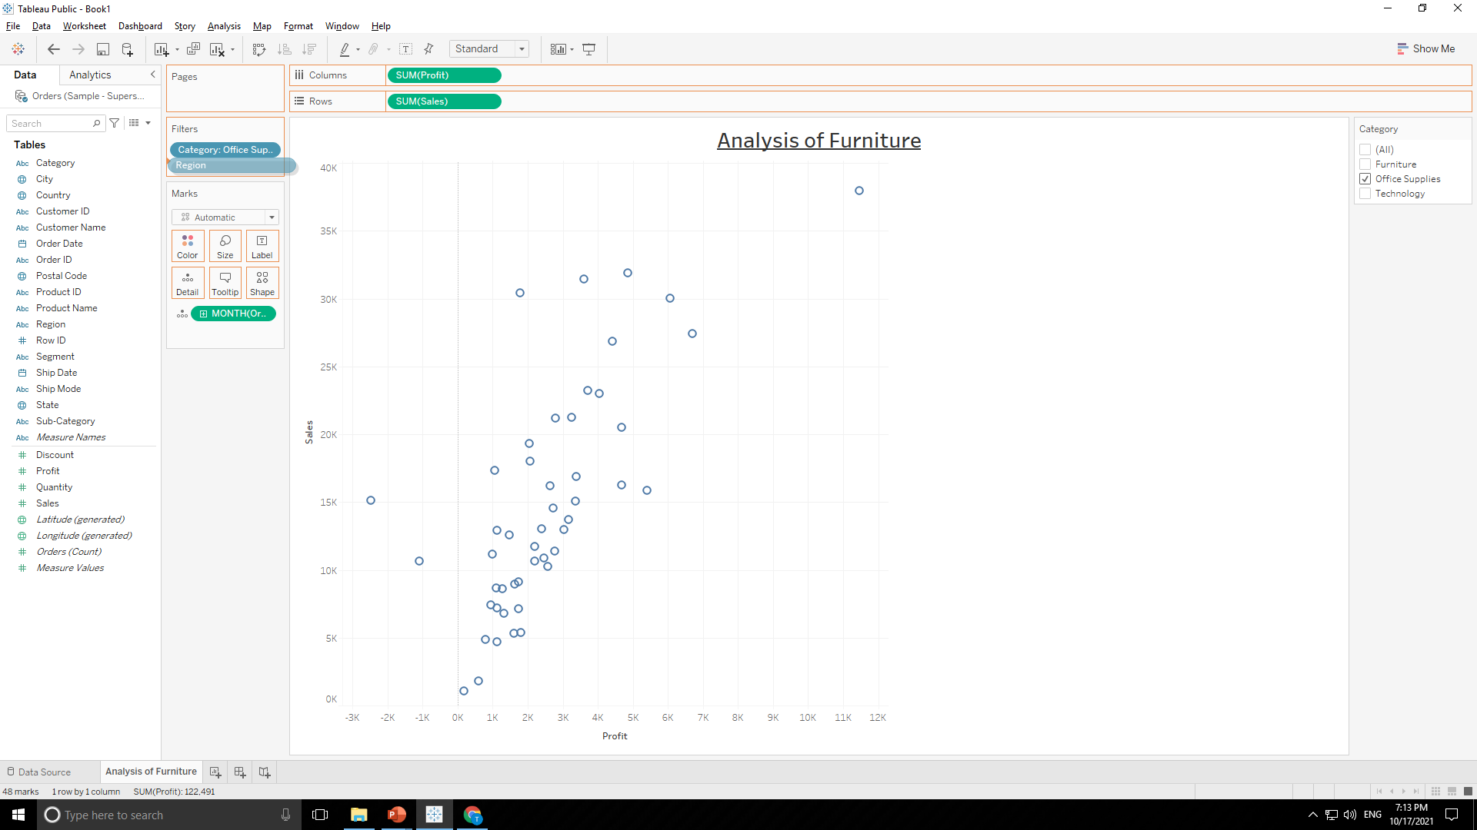
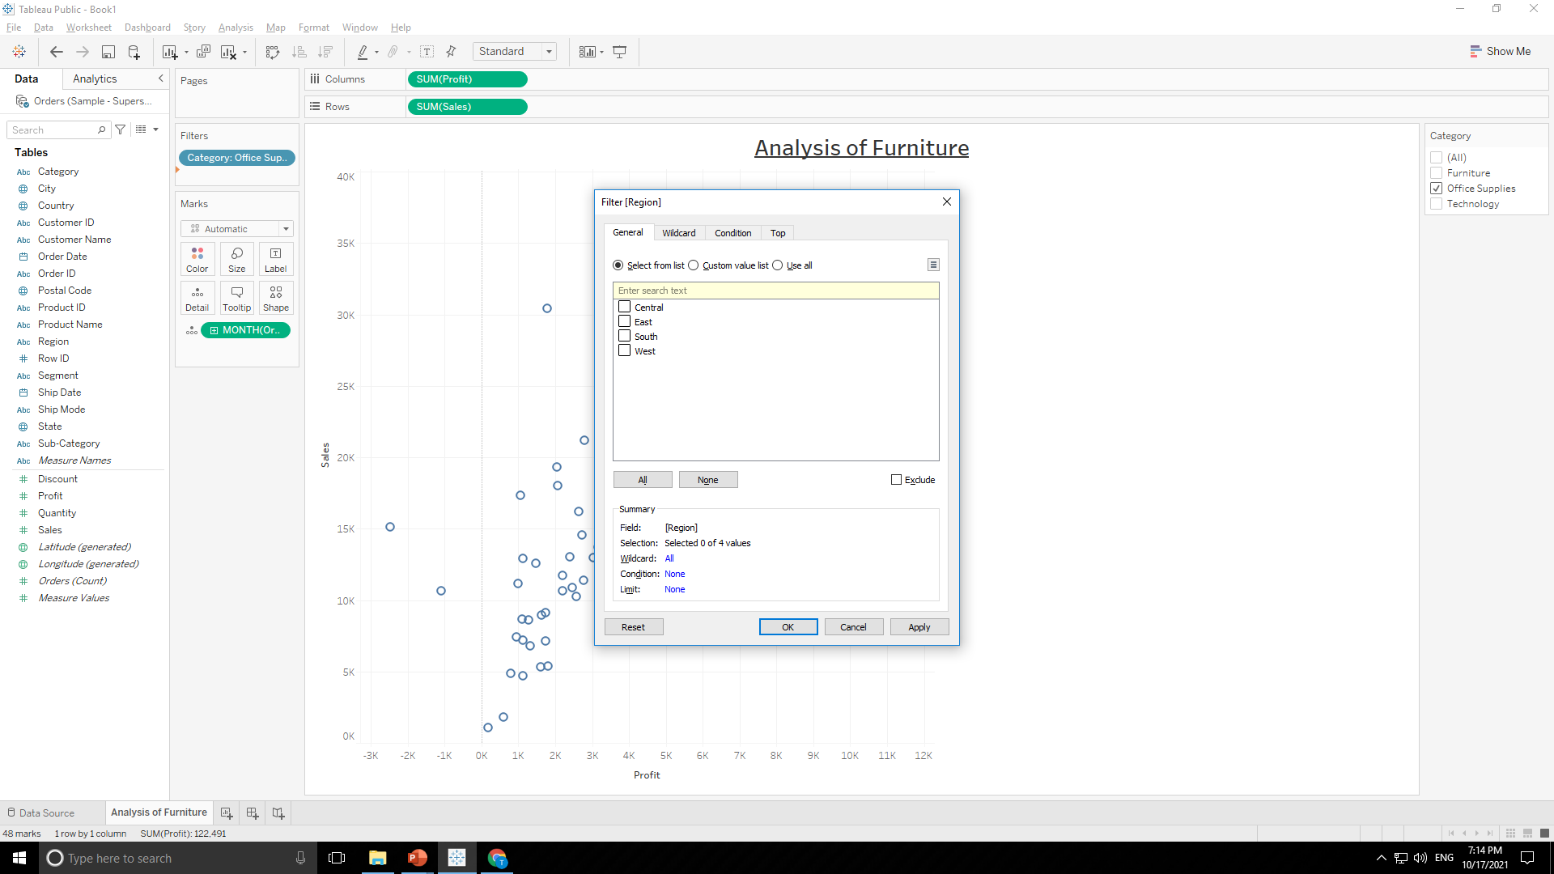
SUPERSTORE DATASOURCE
Now drag & drop “Region” in “Filter Tab” to filter it region wise.

Slide 67
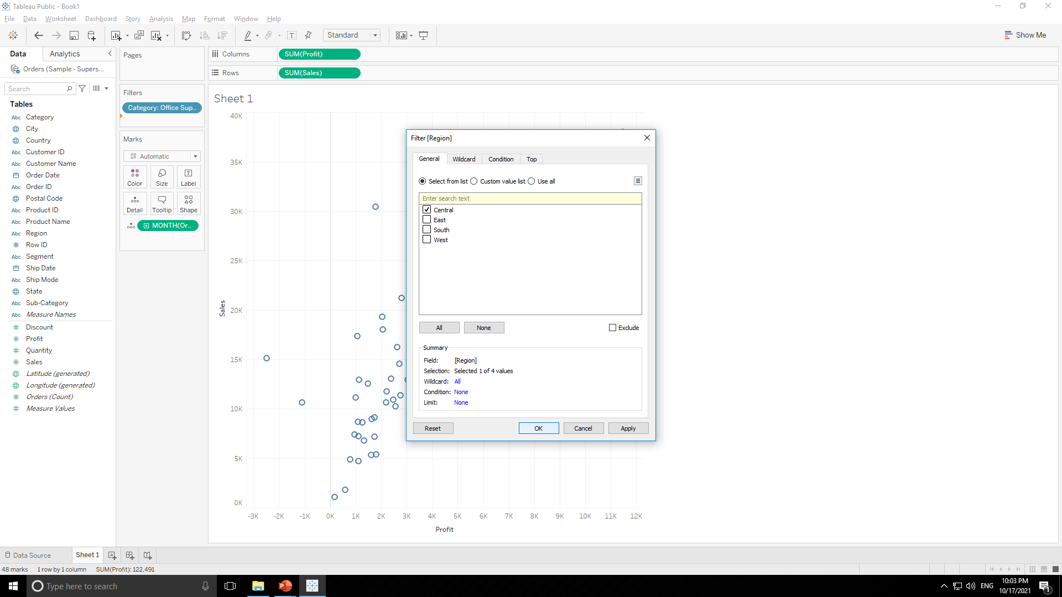

SUPERSTORE DATASOURCE
Tick on ‘Central’ in popup and press OK to filter graph by region as shown below.

Slide 68

SUPERSTORE DATASOURCE
Final Output :

Slide 69

SUPERSTORE DATASOURCE
Final Output :

Slide 70

SUPERSTORE DATASOURCE
5. Create interactive dashboard with appropriate graphs and charts using action filters, images and label formatting.
For this problem make appropriate sheets and combine it to form a dashboard.
Sheet-1

Slide 71

SUPERSTORE DATASOURCE
Sheet-2

Slide 72

SUPERSTORE DATASOURCE
Sheet-3

Slide 73

SUPERSTORE DATASOURCE
Dashboard-1

Slide 74

SUPERSTORE DATASOURCE
Sheet-1

Slide 75

SUPERSTORE DATASOURCE
Sheet-2

Slide 76

SUPERSTORE DATASOURCE
Sheet-3

Slide 77

SUPERSTORE DATASOURCE
Dashboard-2

Slide 78
NETFLIX DATASOURCE
[Use appropriate data joining and blending]
Plot synchronized dual axis chart (line and area) for count of netflix titles of India for release year 2000-2020.
Plot Bubble chart of netflix titles for each year by using single value slider filter for both movie and TV show.
Plot the tree map graph to find count of netflix titles for “Action and Adventure” category for united states.
Plot movie count of specific country as per different ratings.
Plot count of TV shows for different categories using side-by-side bars.
Create dual axis area charts for Movies and TV shows for years 2014-2020.
Create a dashboard with the most useful insights

Slide 79

NETFLIX DATASOURCE
1. Plot synchronized dual axis chart (line and area) for count of netflix titles of India for release year 2000-2020.
Double click on “Release Year” so it will automatically create a graph as shown below.

Slide 80

NETFLIX DATASOURCE
Now Double click on “Netflix titles count” so it will automatically create a graph as shown below.

Slide 81


NETFLIX DATASOURCE
Now filter graph with “Release Year” as shown below.

Slide 82

NETFLIX DATASOURCE
Now graph from year 2000 to 2020 is filtered as shown below.

Slide 83

NETFLIX DATASOURCE
Now drag and drop “Netflix title count” to rows to form two graphs as shown below.

Slide 84


NETFLIX DATASOURCE
Convert one graph to line chart as shown below.

Slide 85


NETFLIX DATASOURCE
Now double click on one graph’s axis and click Dual Axis to merge both graphs as shown below.

Slide 86
NETFLIX DATASOURCE
Final Output :

Slide 87

NETFLIX DATASOURCE
2. Plot Bubble chart of netflix titles for each year by using single value slider filter for both movie and TV show.
Double click on “Release Year” so it will automatically create a graph as shown below.

Slide 88

NETFLIX DATASOURCE
Now Double click on “Netflix titles count” so it will automatically create a graph as shown below.

Slide 89

NETFLIX DATASOURCE
Now convert chart to “Bubble Chart” by clicking “Show Me” tab.

Slide 90


NETFLIX DATASOURCE
Now filter the graph by both “Type” i.e. Movie & TV Shows by ticking it and then hit ok button as shown below.

Slide 91


NETFLIX DATASOURCE
Apply “Show Filter” & remove “Show All Value” option as shown below in filter tab.

Slide 92

NETFLIX DATASOURCE

Slide 93


NETFLIX DATASOURCE
Apply “Slider” option as shown below in filter tab.

Slide 94

NETFLIX DATASOURCE
3. Plot the tree map graph to find count of netflix titles for “Action and Adventure” category for united states.

Slide 95

NETFLIX DATASOURCE
4. Plot movie count of specific country(India) as per different ratings.

Slide 96

NETFLIX DATASOURCE
5. Plot count of TV shows for different categories using side-by-side bars.

Slide 97

NETFLIX DATASOURCE
6. Create dual axis area charts for Movies and TV shows for years 2014-2020

Slide 98

NETFLIX DATASOURCE
7. Create a dashboard with the most useful insights

Slide 99
CREATING DASHBOARDS & STORIES
Follow the instructions given in next slides to create dashboards and stories for the data sources given below
EdX_2013 Academic Year Courses
IPL_dataset.csv
Summer_Olympic_medallists_1896-2008
Pokemon
LINK: https://drive.google.com/drive/folders/1hQZur3Howub0xR5KD3SDfOmdkdLjpLuH?usp=sharing

Slide 100
CREATE DASHBOARDS FOR THE DATA SOURCES
Gather and prepare the data using appropriate joining and blending of tables
Determine the objective or message for data visualization
Use advanced visualization and data manipulation (calculated fields, action filters, dual axis etc) covered in the course
Use multiple sheets (above 3) in your dashboard
Build an interactive data visualization dashboard

Slide 101

CREATE DASHBOARDS FOR THE DATA SOURCES - POKEMON

Slide 102

CREATE DASHBOARDS FOR THE DATA SOURCES - Summer Olympics Medalist

Slide 103

CREATE DASHBOARDS FOR THE DATA SOURCES - Academic Year Courses

Slide 104

CREATE DASHBOARDS FOR THE DATA SOURCES - Academic Year Courses

Slide 105

CREATE DASHBOARDS FOR THE DATA SOURCES - IPL

Slide 106

CREATE DASHBOARDS FOR THE DATA SOURCES - IPL

Slide 107
CREATE STORIES USING THE DASHBOARDS AND WORKSHEETS
Prepare individual worksheets to create a dashboard
Determine the dashboard (objective) or message for data visualization
Create interactive dashboard (use action filters, parameters, bins and grouping concepts)
Generate different insights from the dashboard by applying filters and grouping parameters
Use different insights from the dashboard and use different worksheets to generate a story

